Slide 1
Case Management
Lecturer: Ngo Huy Bien
Software Engineering Department
Faculty of Information Technology
VNUHCM - University of Science
Ho Chi Minh City, Vietnam
nhbien@fit.hcmus.edu.vn

Slide 2

Objectives
To customize Cases settings.
To create Record Types for Cases.
To use Conga for generating documents from records.

Slide 3

Contents
Cases Settings
Report Types
Conga Composer

Slide 4

References

Slide 5
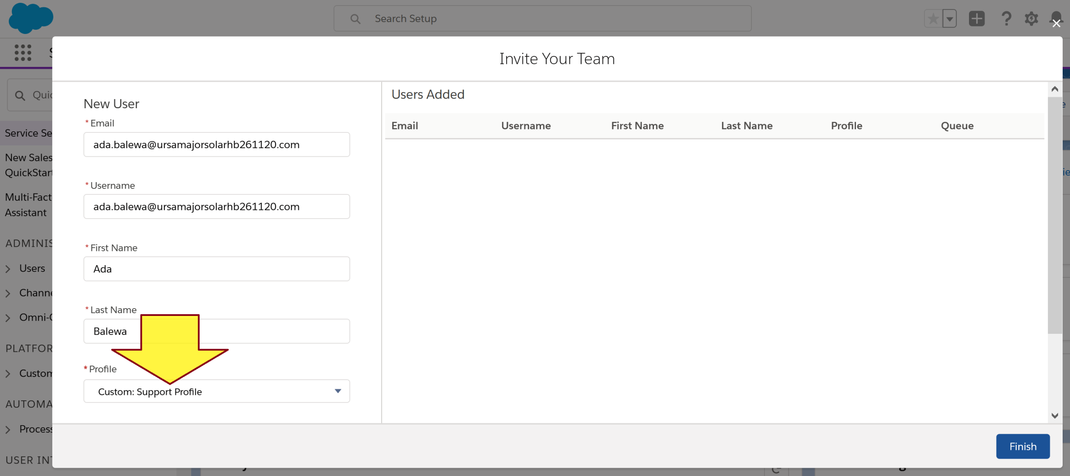
1. Add a Customer Support Specialist
https://trailhead.salesforce.com/en/content/learn/projects/set-up-case-escalation-entitlements/create-support-processes-cases
Service Setup → Add Your Users

Slide 6
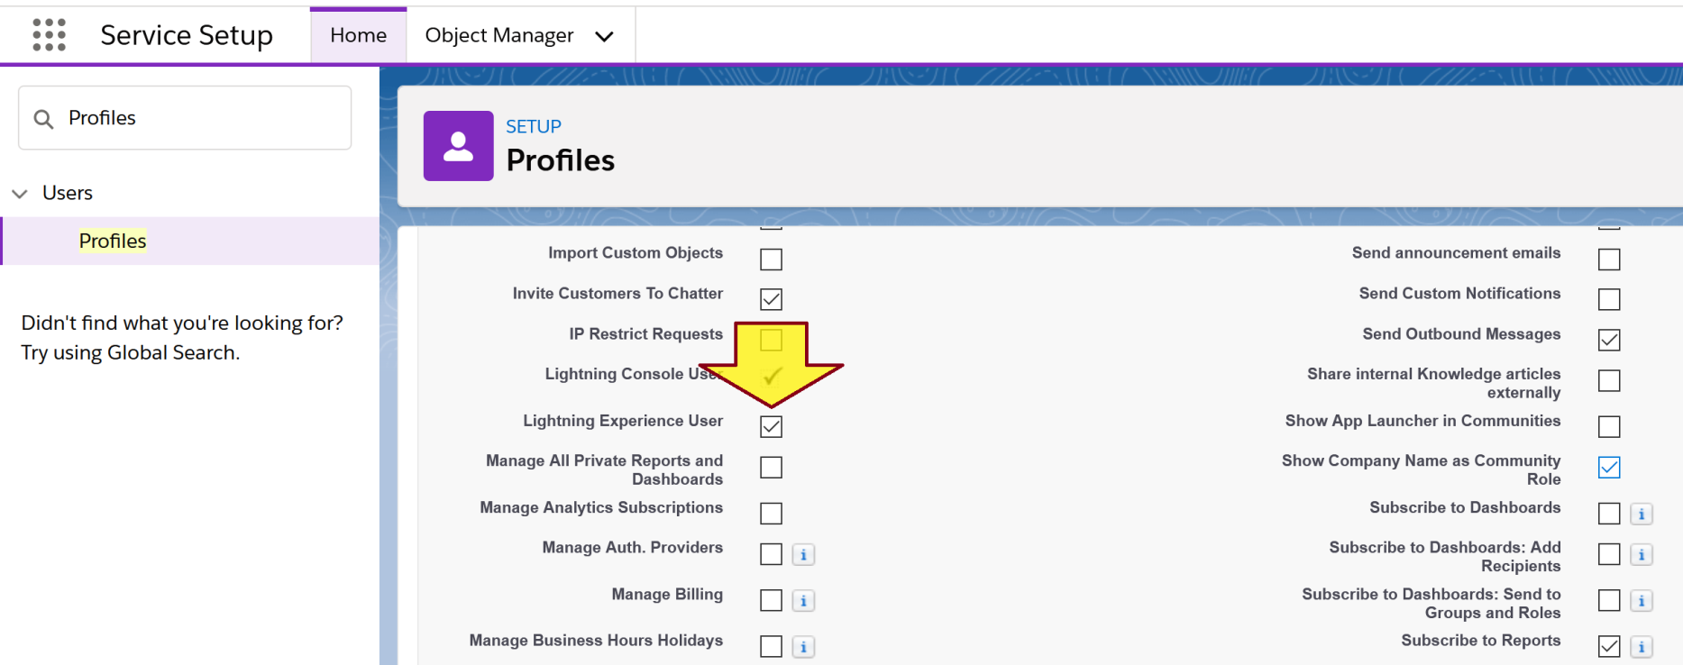
2. Enable Lightning Experience User Admin Access
Service Setup → Profiles → Edit (Custom: Support Profile)

Slide 7
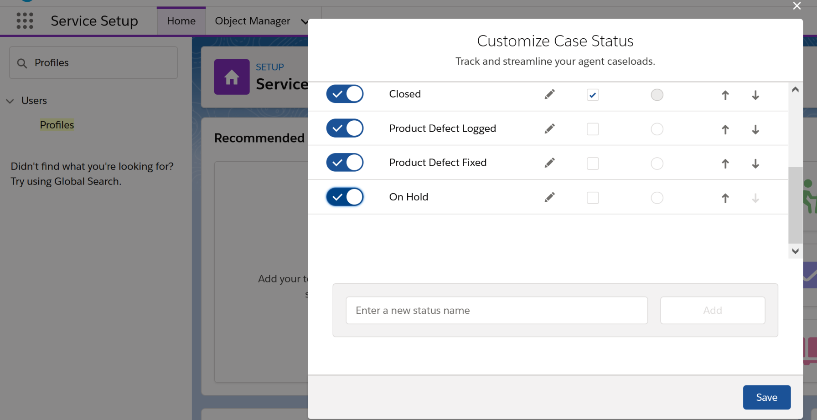
3. Add a New Case Status
Service Setup → Home → Customize Case Status

Slide 8
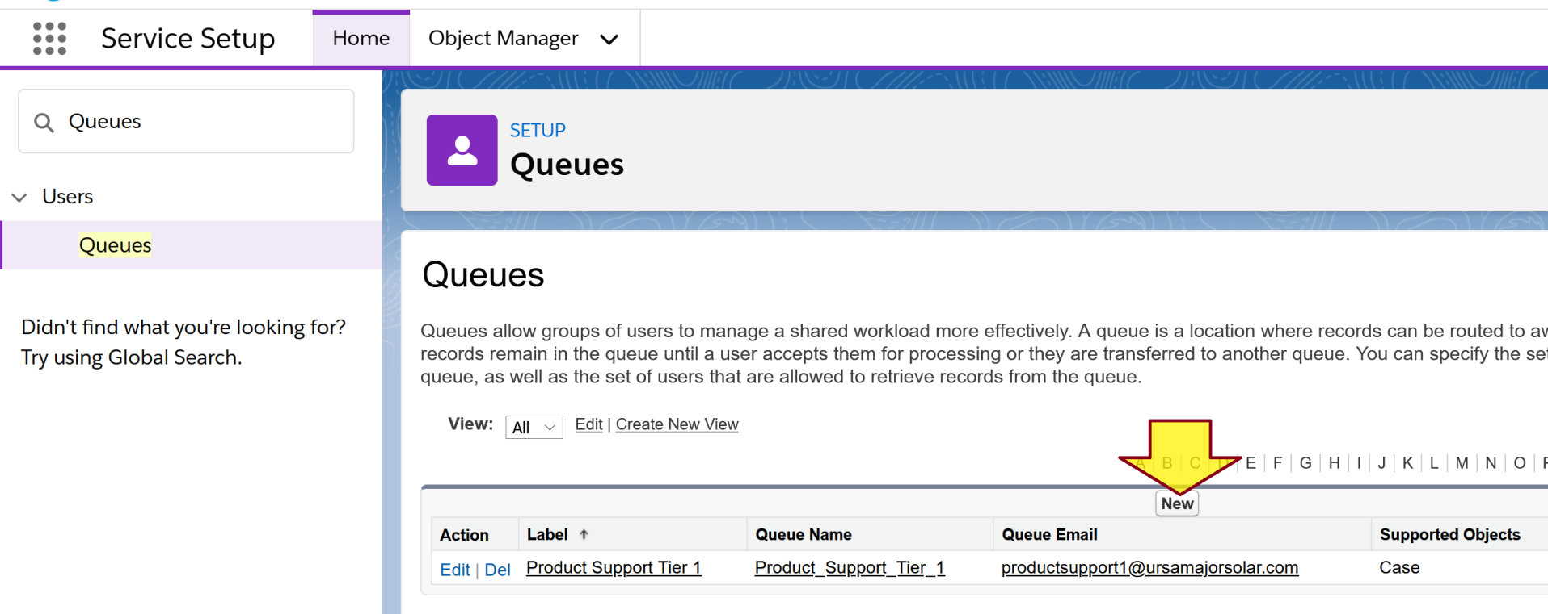
4. Create a Queue
https://trailhead.salesforce.com/content/learn/projects/set-up-case-escalation-entitlements/create-case-queues-assignment-rule
Service Setup → Queues

Slide 9
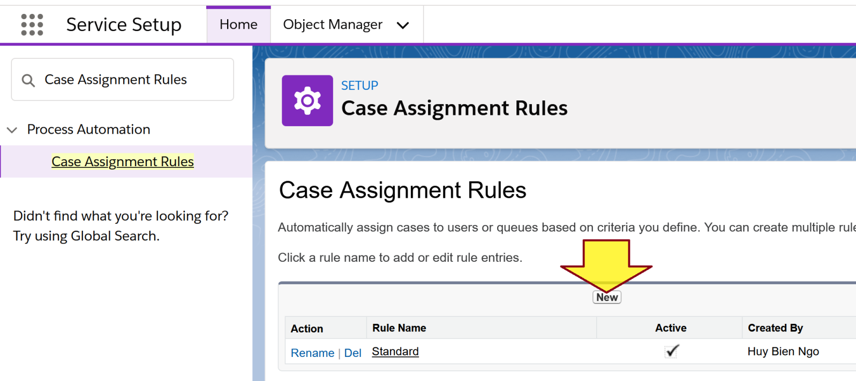
5. Create a Case Assignment Rule
Service Setup → Case Assignment Rules

Slide 10
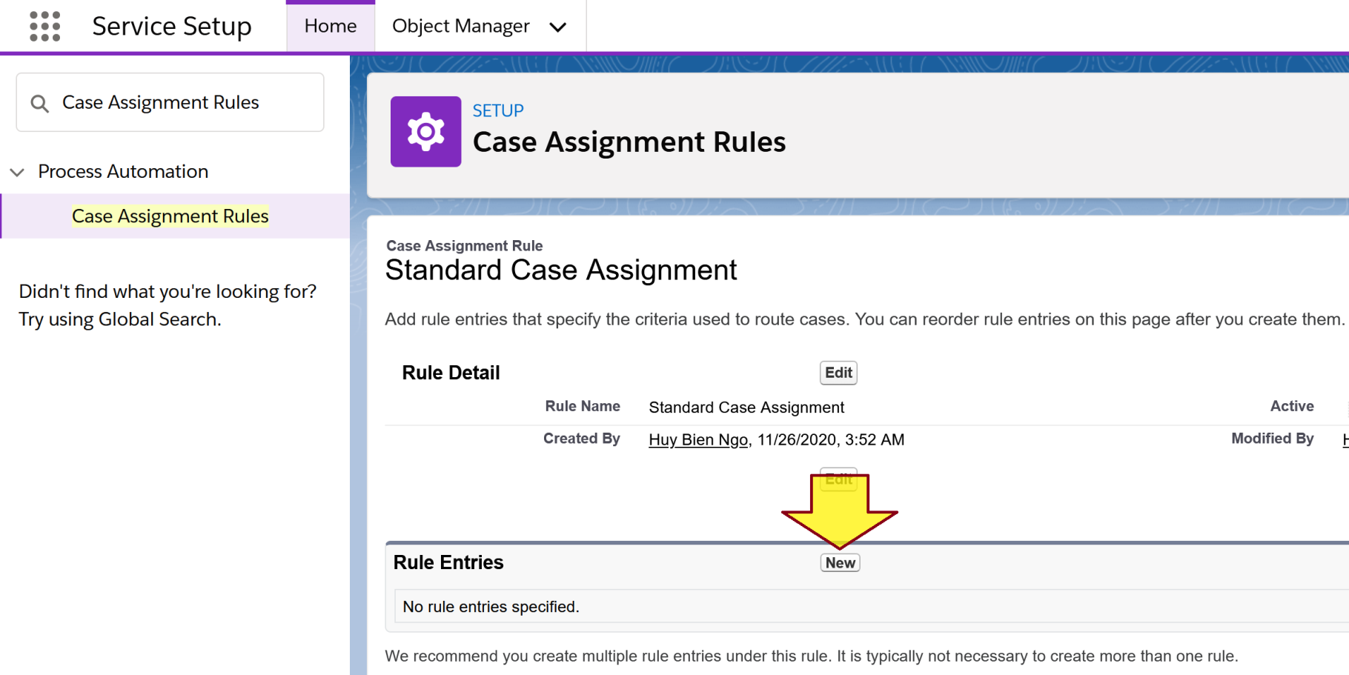
6. Create a Rule Entry
Click on a Case Assignment Rule.

Slide 11
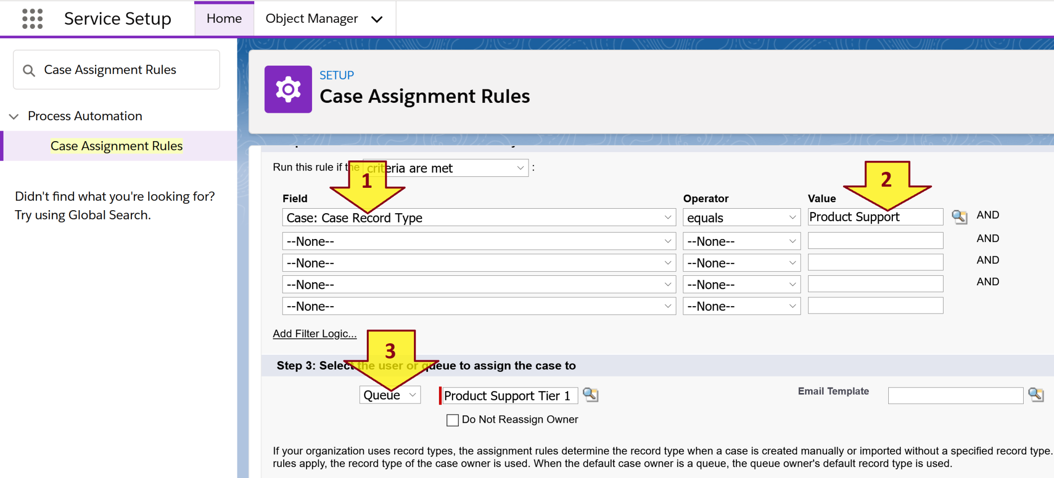
7. Enter Rule Entry Information

Slide 12
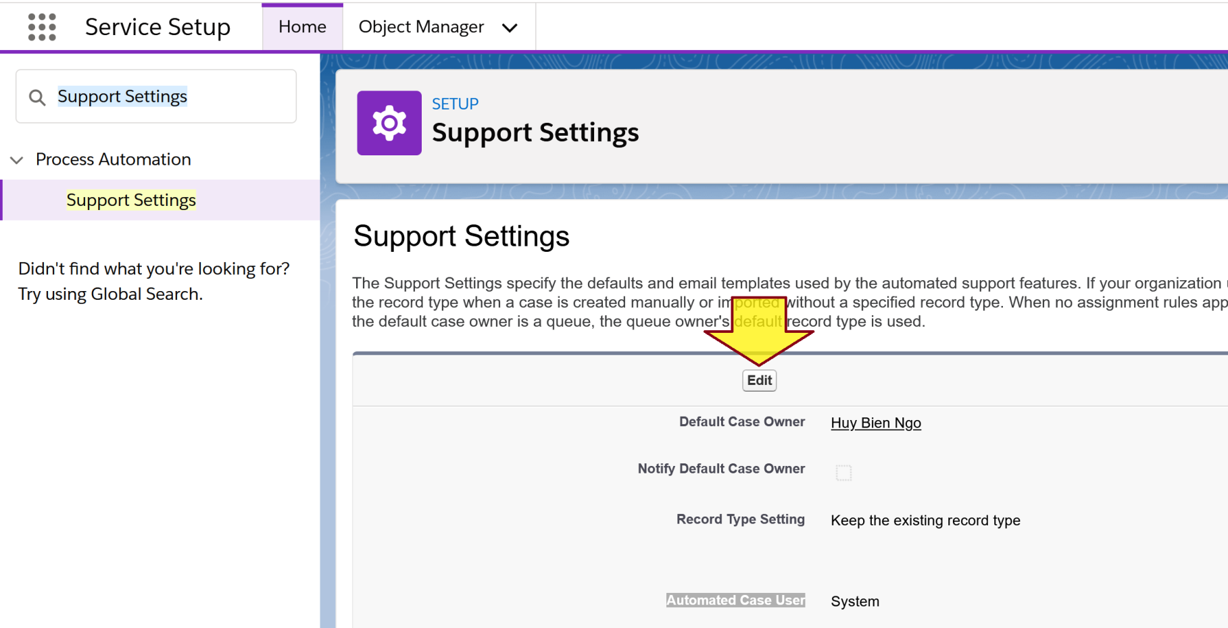
8. Modify Automated Case User
Service Setup → Support Settings

Slide 13
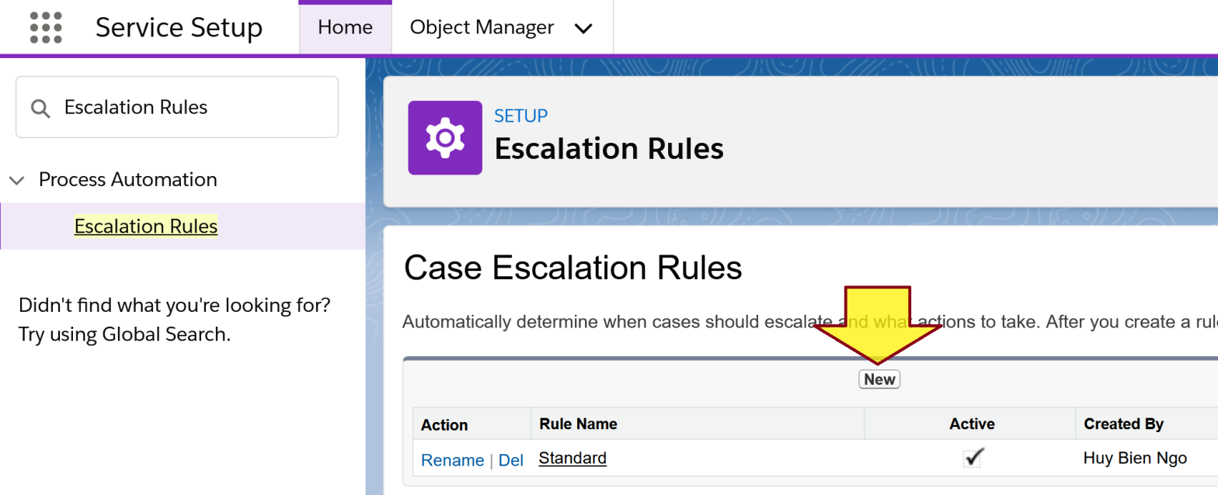
9. Create a Case Escalation Rule
https://trailhead.salesforce.com/en/content/learn/projects/set-up-case-escalation-entitlements/create-case-escalation-rule
Service Setup → Escalation Rules

Slide 14
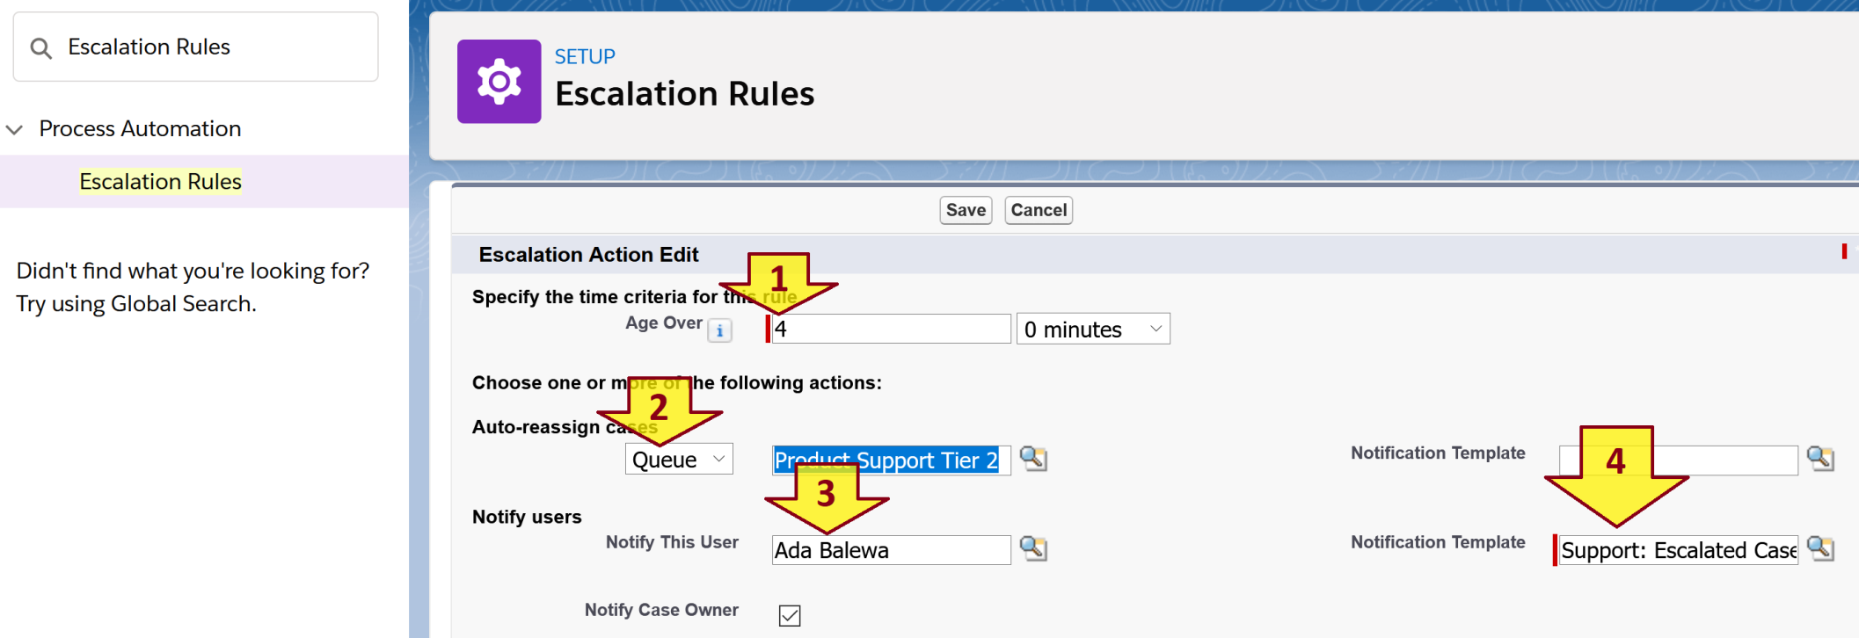
10. Create an Escalation Rule Action

Slide 15
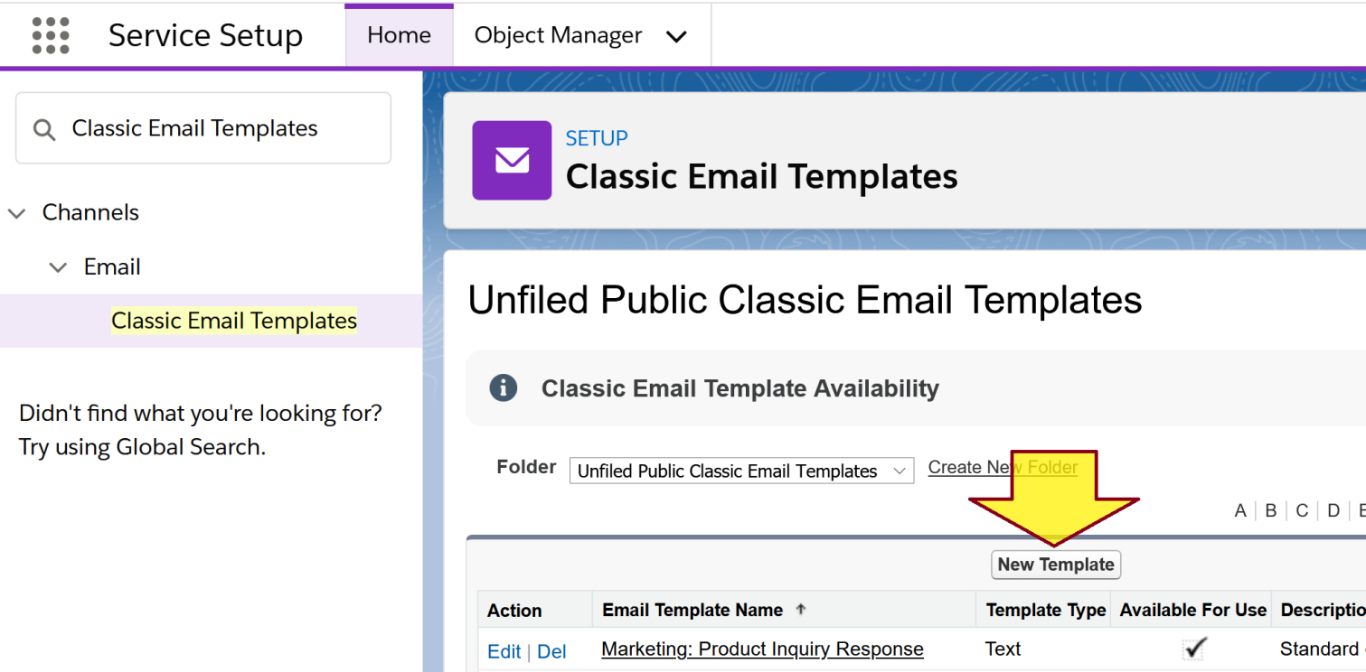
11. Create an Email Template
https://trailhead.salesforce.com/en/content/learn/projects/set-up-case-escalation-entitlements/create-flow-with-process-builder
Service Setup → Classic Email Templates

Slide 16
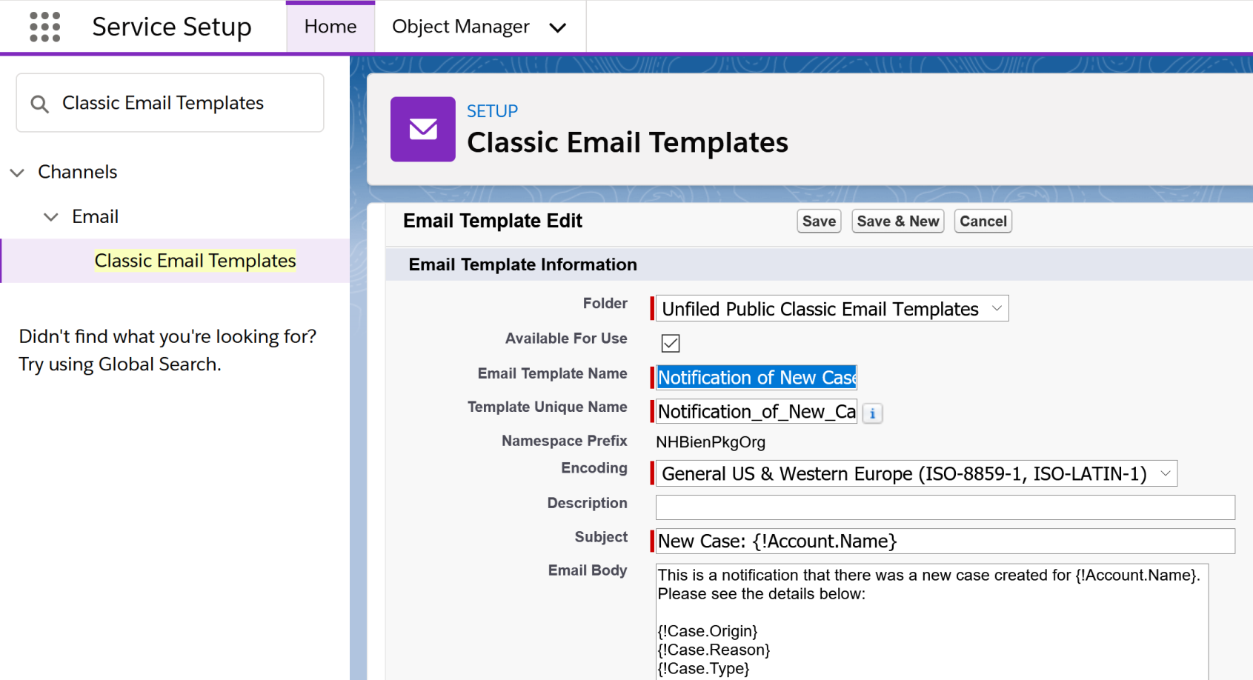
12. Enter Email Template Information

Slide 17
Case Fields
https://help.salesforce.com/articleView?id=cases_fields.htm
Contact Email | Email address of a case’s contact. The address is added when you add a contact to a case. This field is read only.
Contact Fax | Fax number of a case’s contact. This number is added when you add a contact to a case. This field is read only.
Contact Mobile | Mobile phone number of a case’s contact. The number is added when you add a contact to a case. This field is read only.
Contact Name | Name of a case’s contact.
Contact Phone | Phone number of a case’s contact. The number is added when you add a contact to a case. This field is read only.
Created By | User who created a case, including creation date and time. This field is read only.

Slide 18


Slide 19
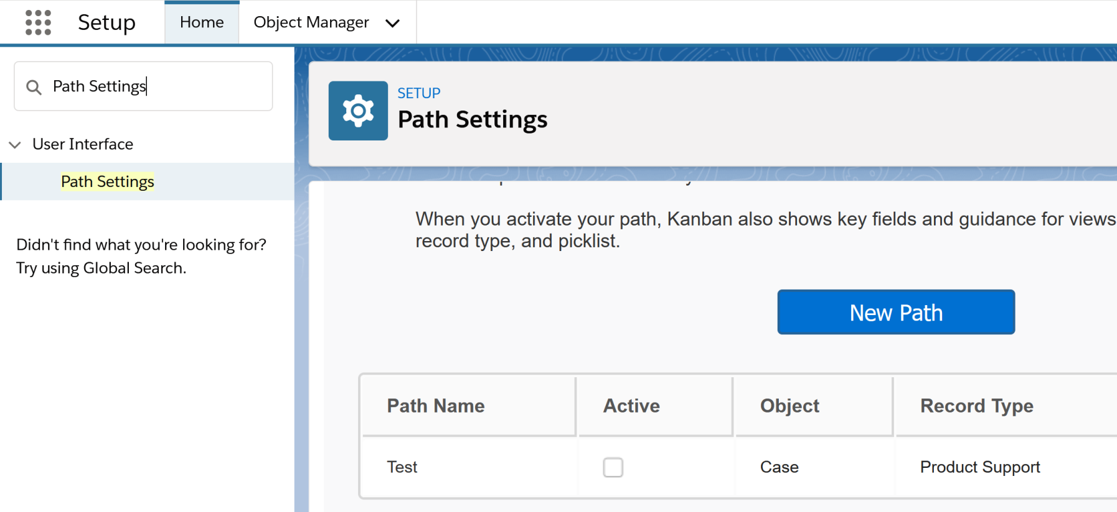
1. Add a Path for a Case Record Type
Setup → Path Settings

Slide 20
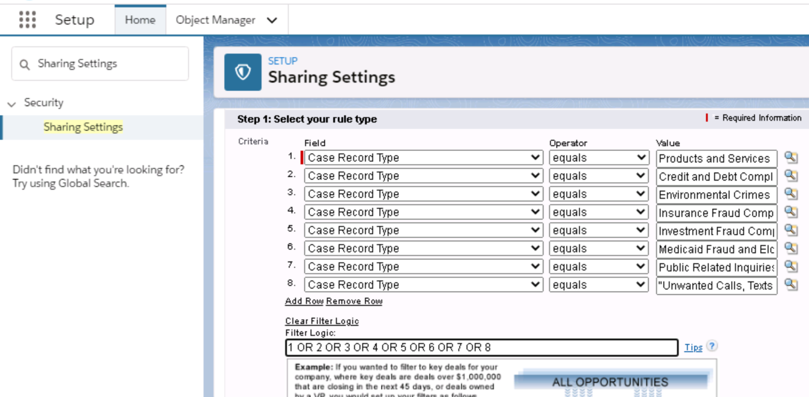
2. Configure Case Record Type Access
Setup → Sharing Settings → Case

Slide 21
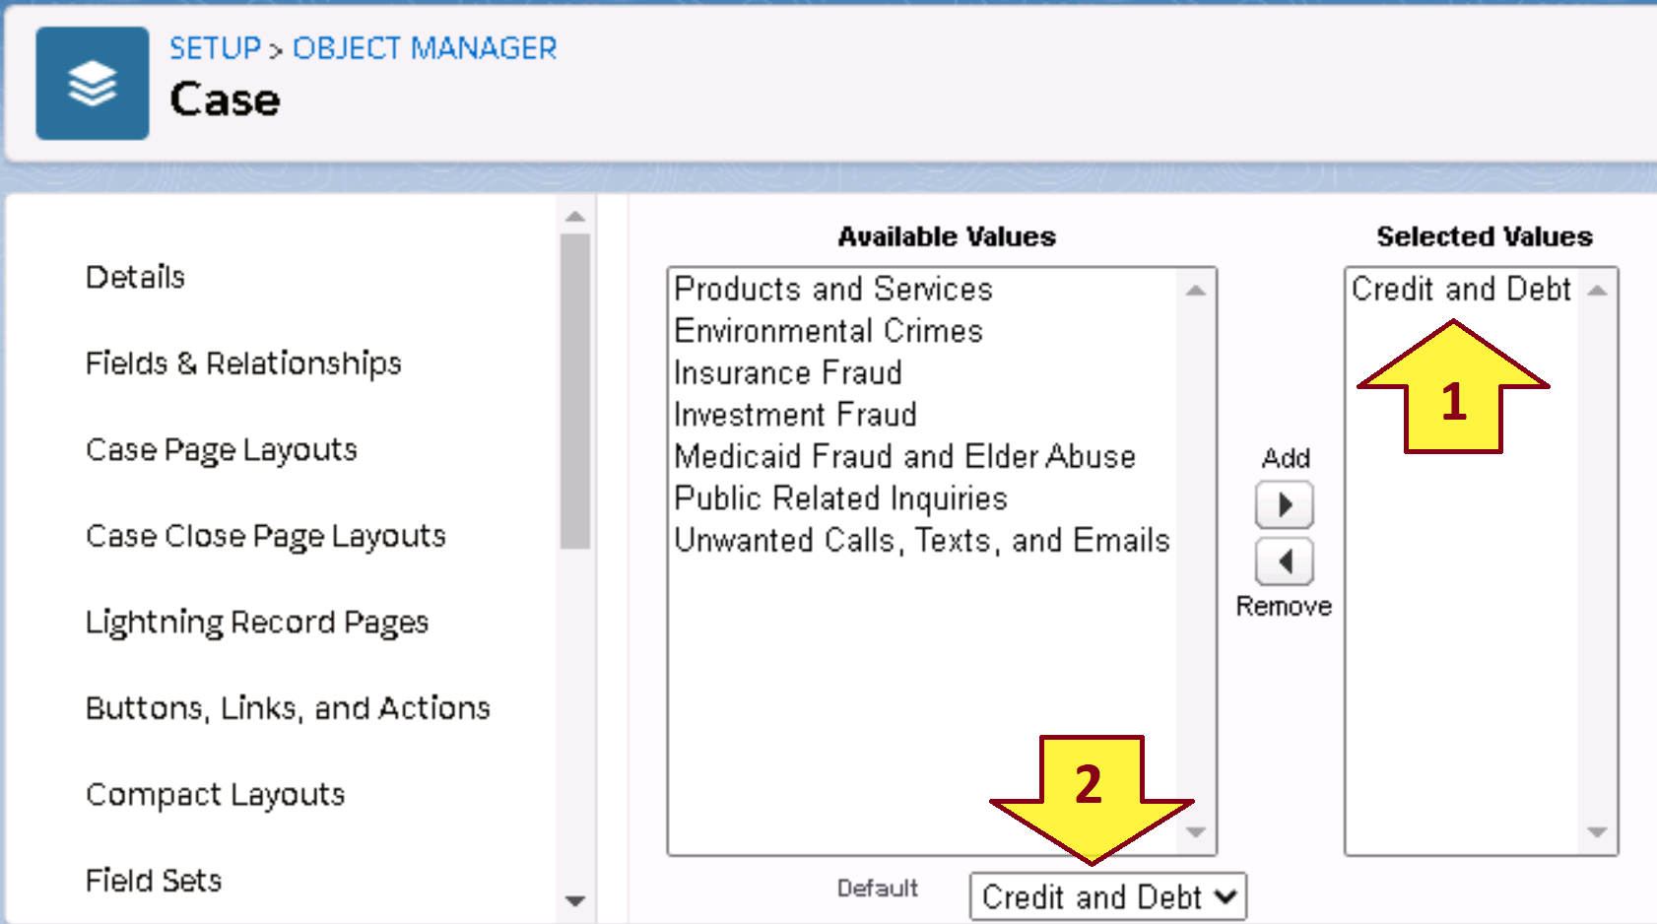
3. Limit Pick List Values for a Record Type
Setup → Object Manager → Case → Record Types
Click a Record Type.
Scroll down to Picklists Available for Editing.
Click a Pick List.

Slide 22
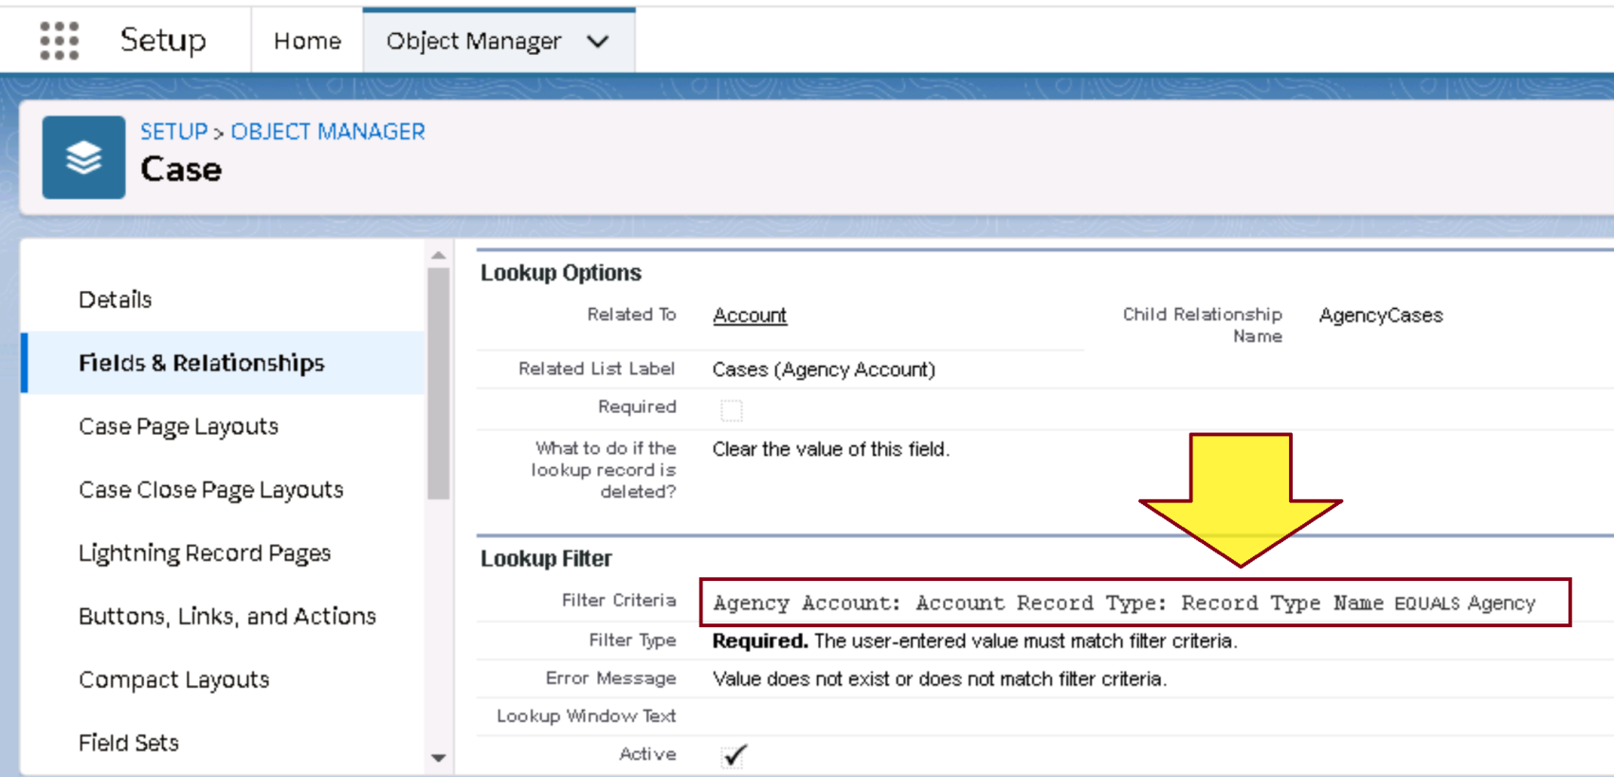
4. Filter Lookup Field By Record Type
Go to Account Lookup field that you have created.
Under Lookup Filter Section, click Show Filter Section.
Add Account Record Type → Record Type Name.

Slide 23
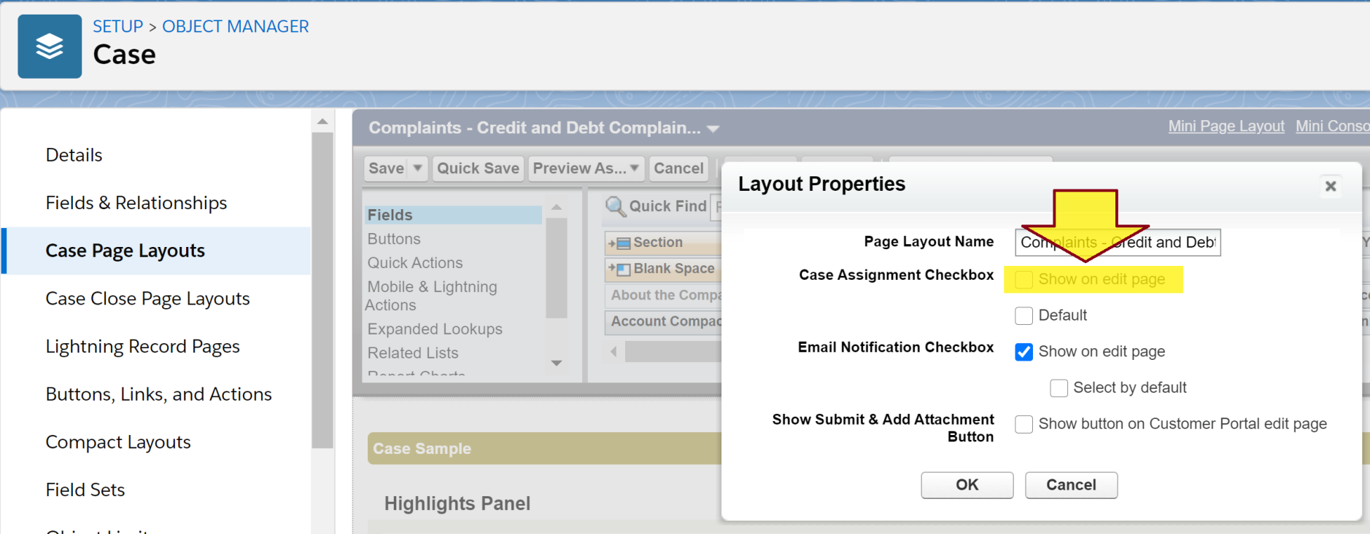
5. Set the Option 'Assign using active assignment rules' to True
https://help.salesforce.com/articleView?id=000333678&type=1
Click the 'Layout Properties' button on the palette.
Disable the 'Show on edit page' and ‘Default' Case Assignment Check-box.
Click OK, then click Save.

Slide 24
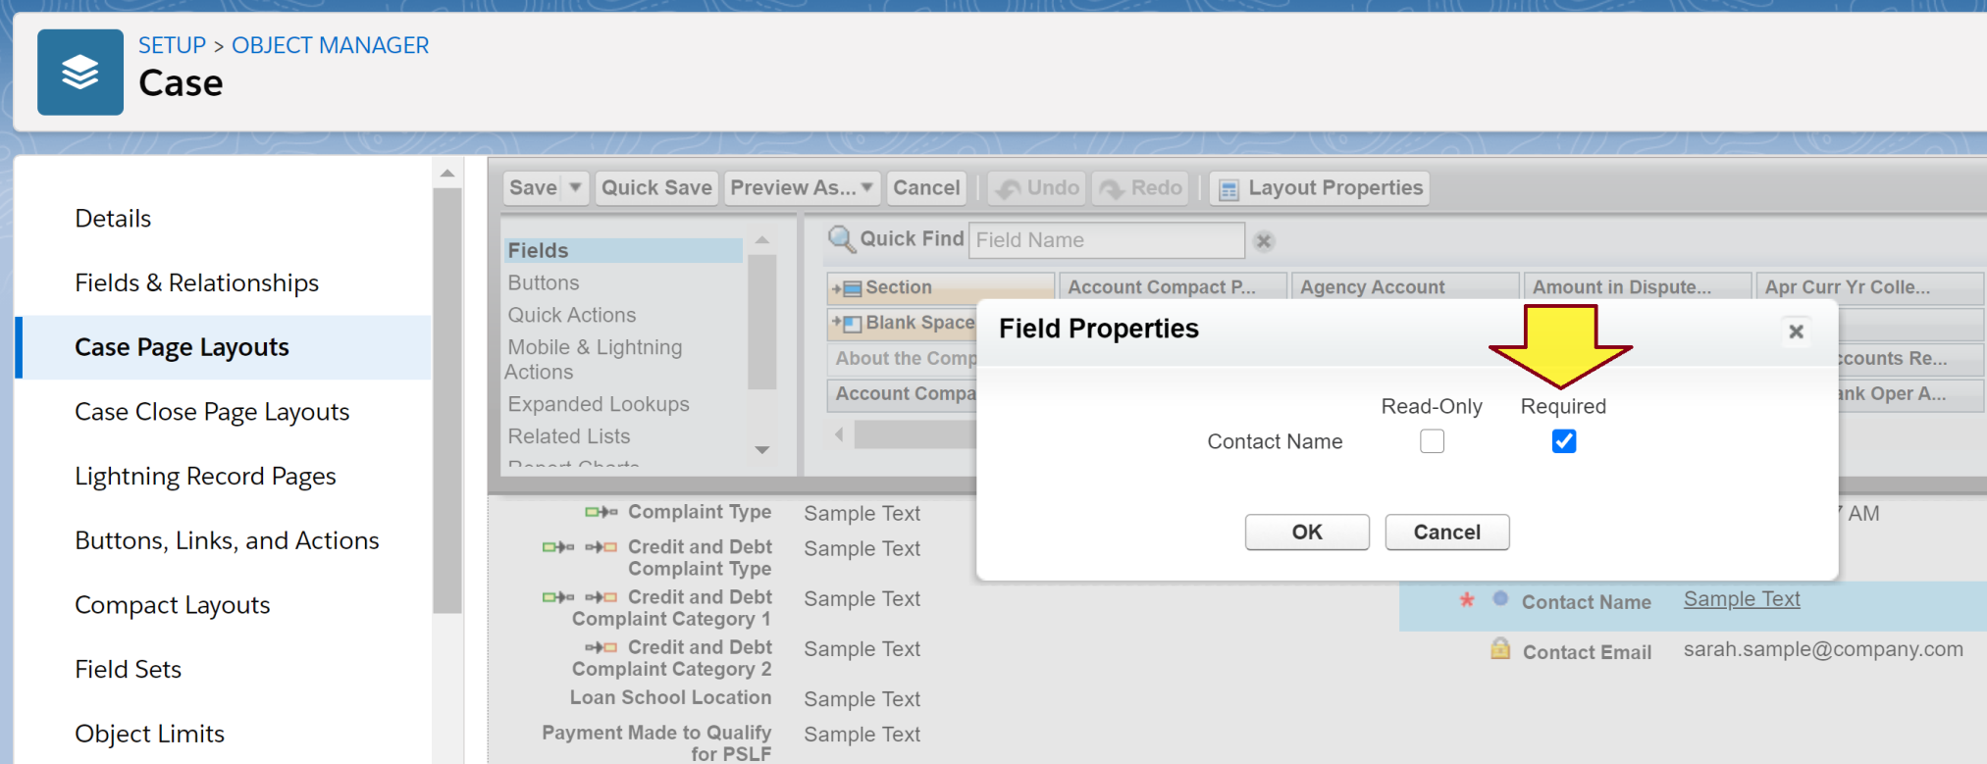
6. Set Contact Field As Required

Slide 25
7. Choose a Default Case Owner
https://trailhead.salesforce.com/en/content/learn/modules/service_basics/service_basics_create_customer_channels
Setup → Support Settings.

Slide 27
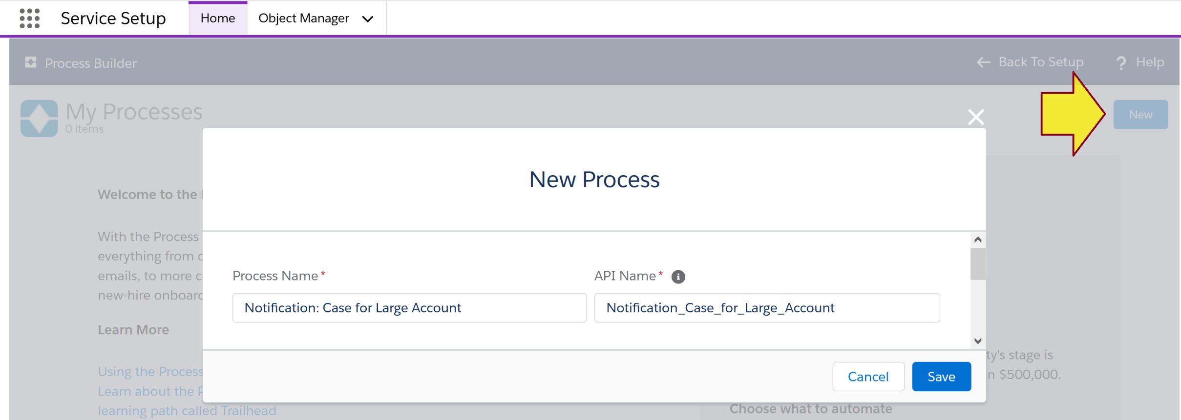
1. Create a Process
Use case: Send email about important Case.
https://trailhead.salesforce.com/en/content/learn/projects/set-up-case-escalation-entitlements/create-flow-with-process-builder
Service Setup → Process Builder

Slide 28
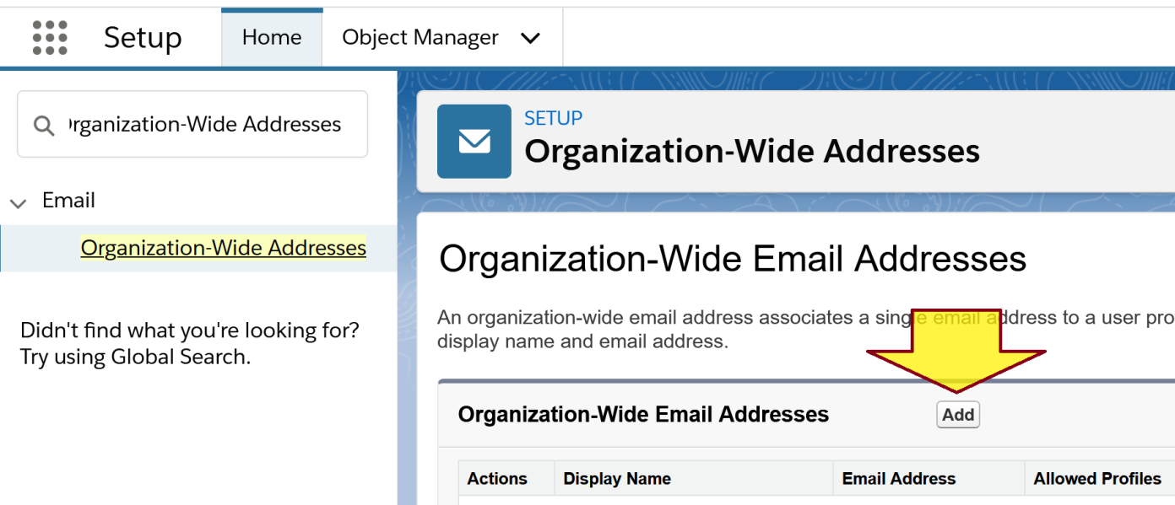
2. Create Organization-Wide Email Address
Use case: Setup FROM EMAIL for Email Alerts.
Setup → Organization-Wide Addresses.

Slide 29
Setup Email-to-Case
https://trailhead.salesforce.com/en/content/learn/modules/service_basics/service_basics_create_customer_channels
Setup → Email-to-Case.

Slide 30
Create a DKIM Key
https://help.salesforce.com/articleView?id=emailadmin_create_secure_dkim.htm

Slide 31
Add Salesforce to SPF Record
https://help.salesforce.com/articleView?id=emailadmin_spf_include_salesforce.htm

Slide 33
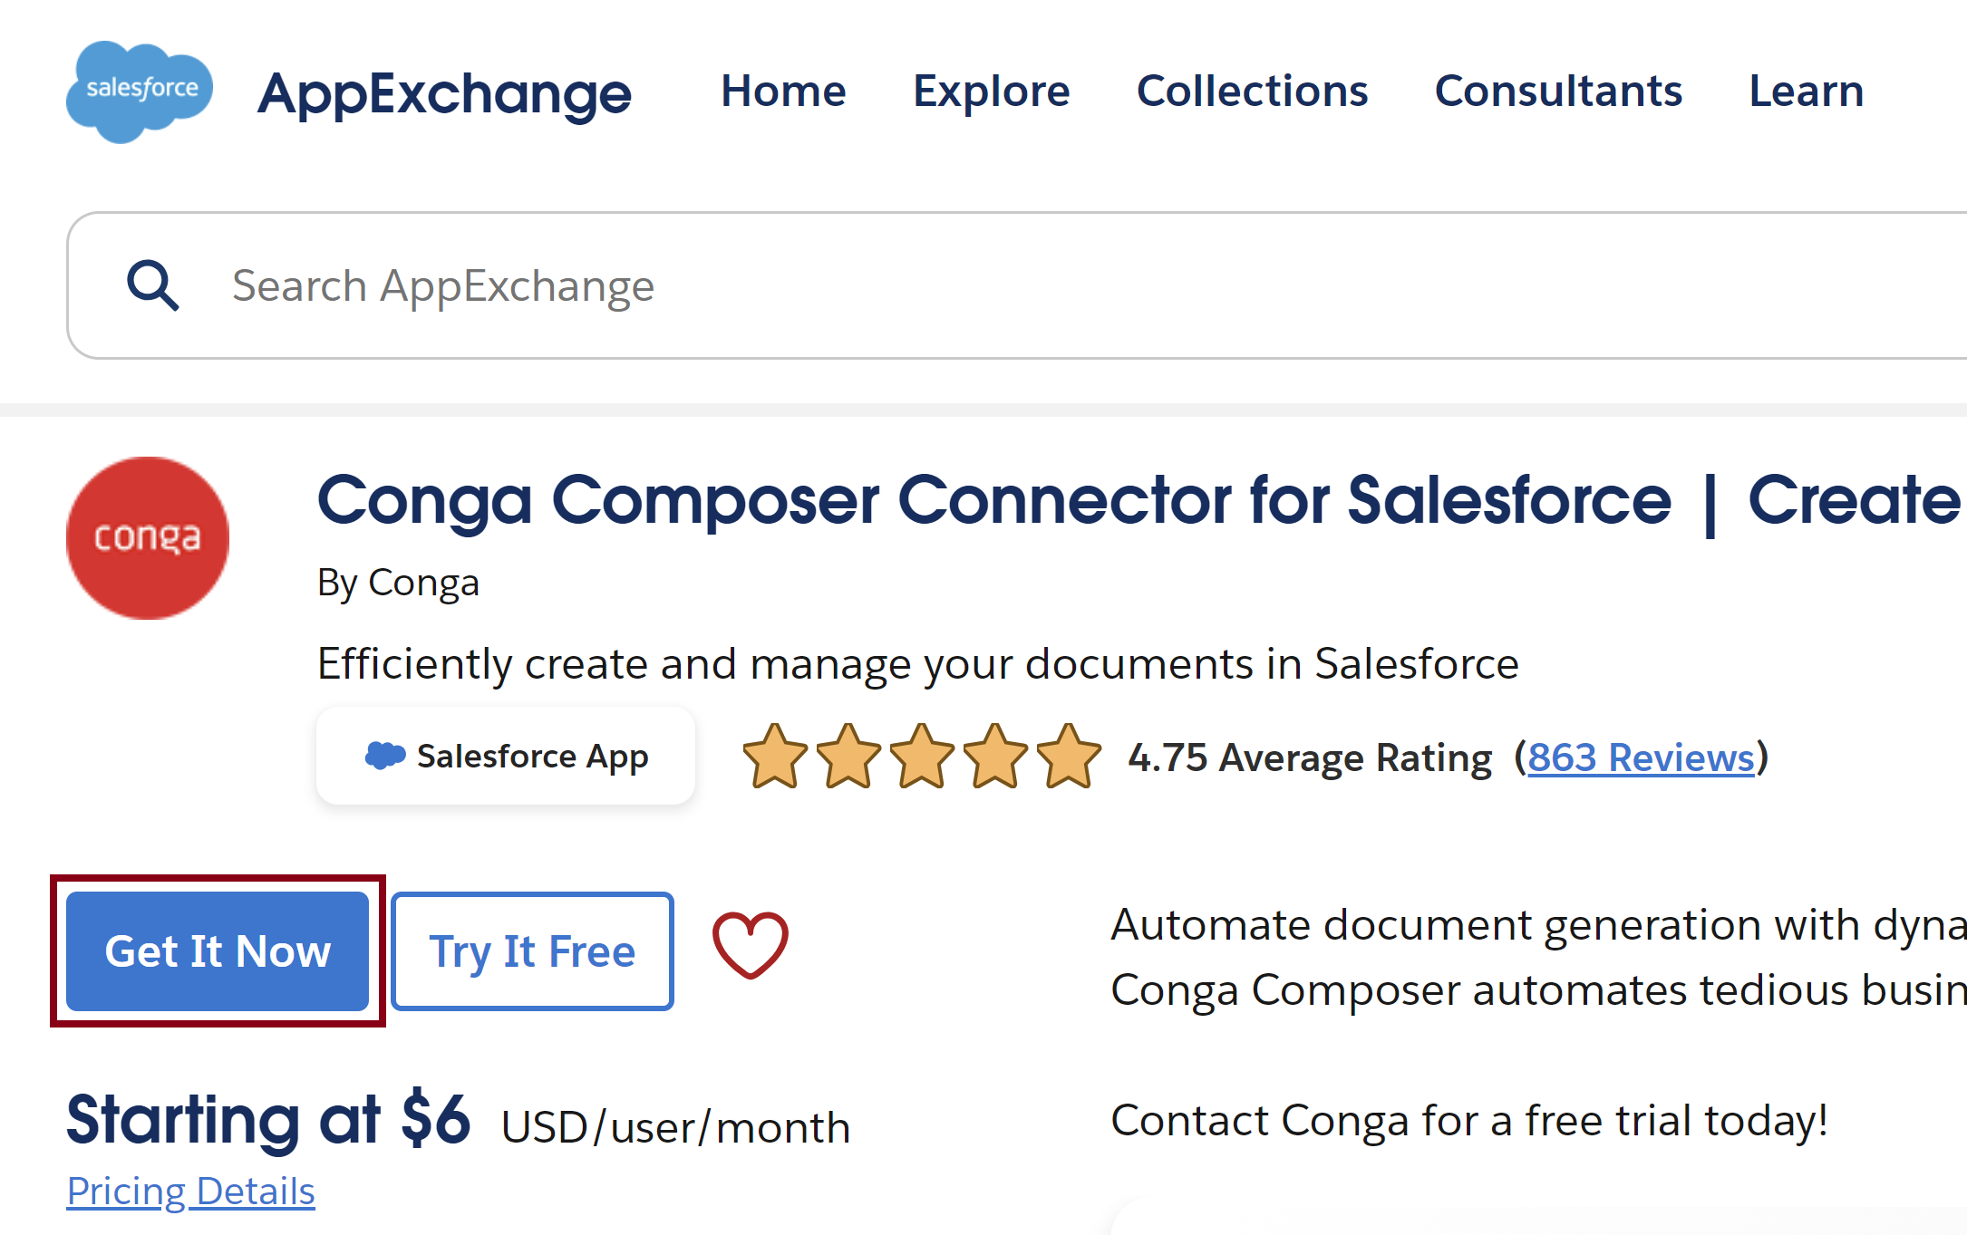
1. Install Conga Composer
https://appexchange.salesforce.com/appxListingDetail?listingId=a0N300000016b7FEAQ

Slide 34
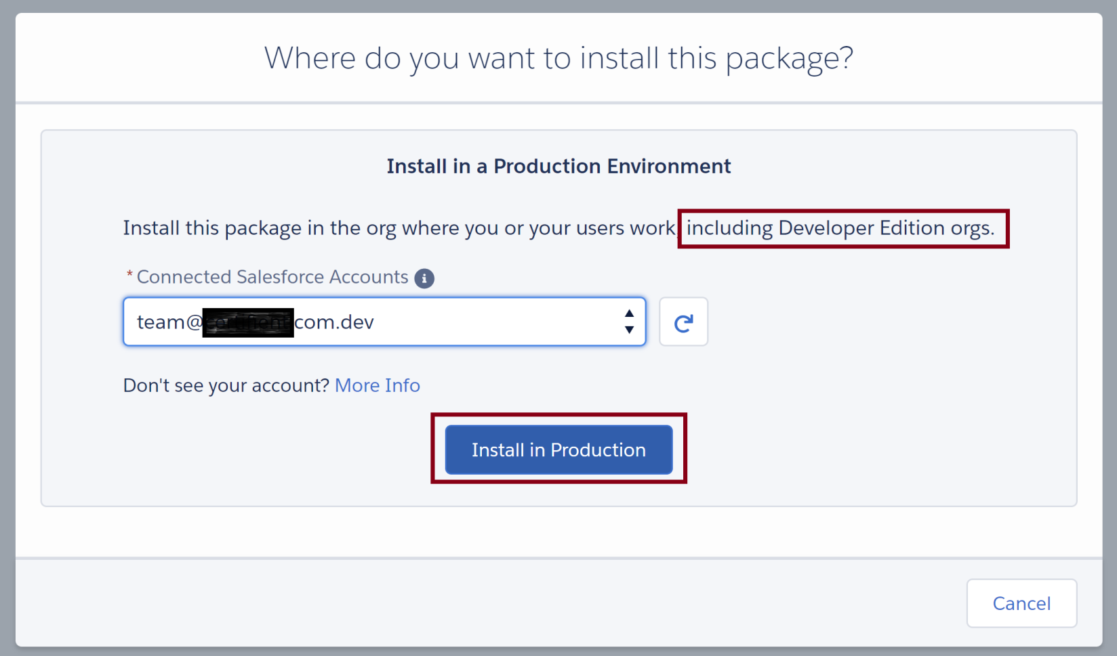
2. Select Account

Slide 35
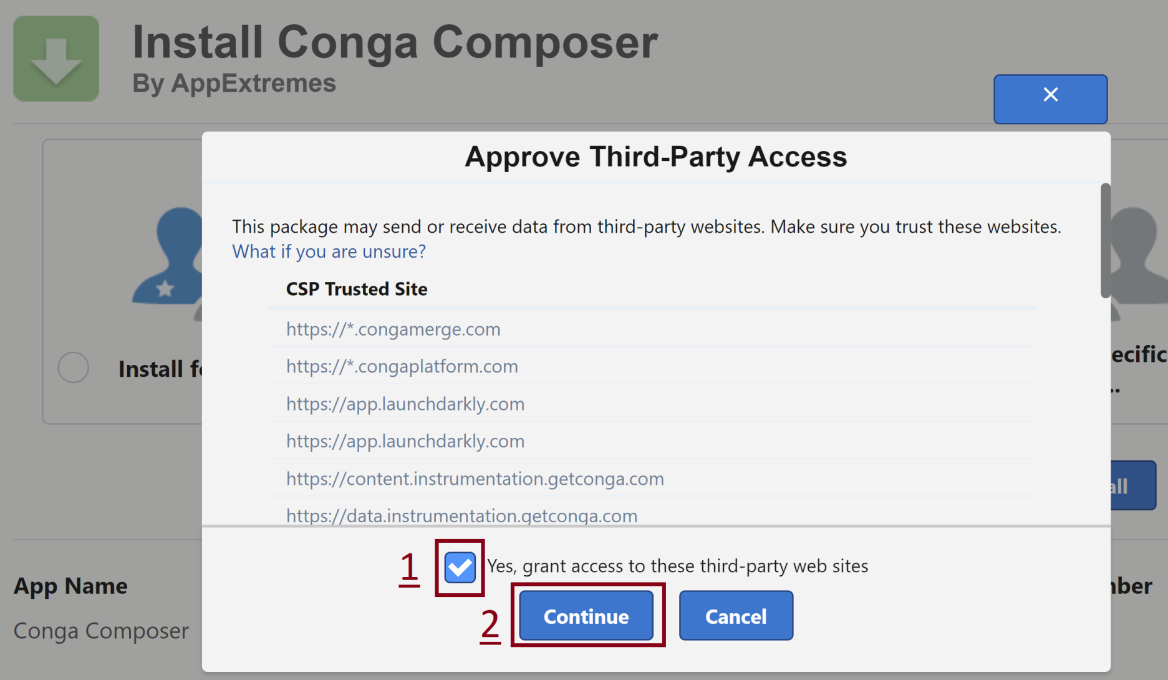
3. Grant Access

Slide 36
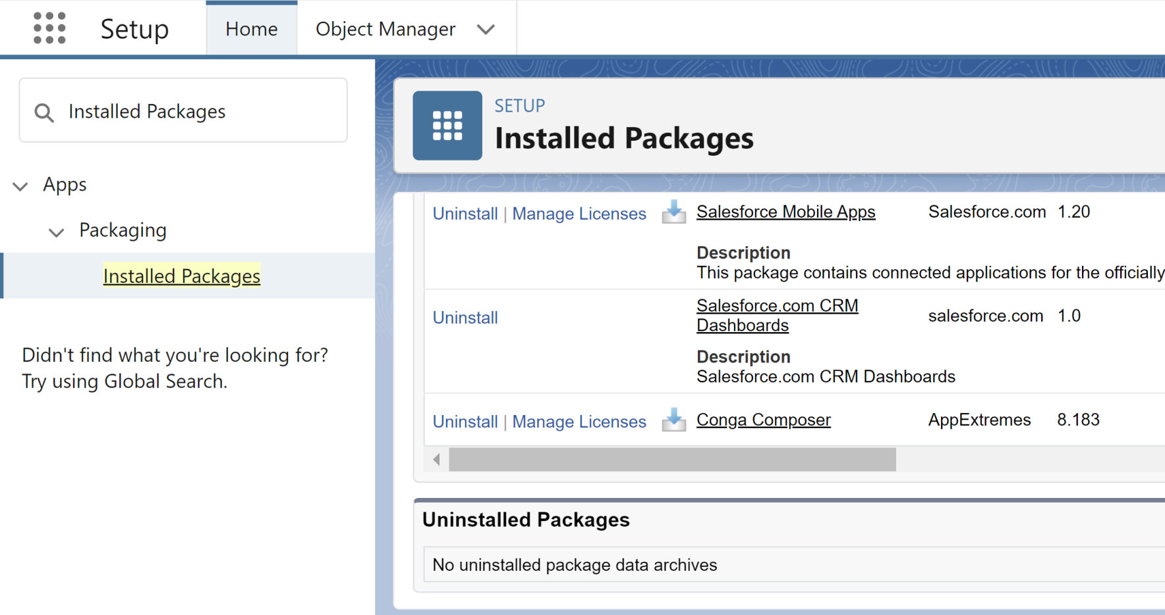
3. Manage Conga Licenses

Slide 37
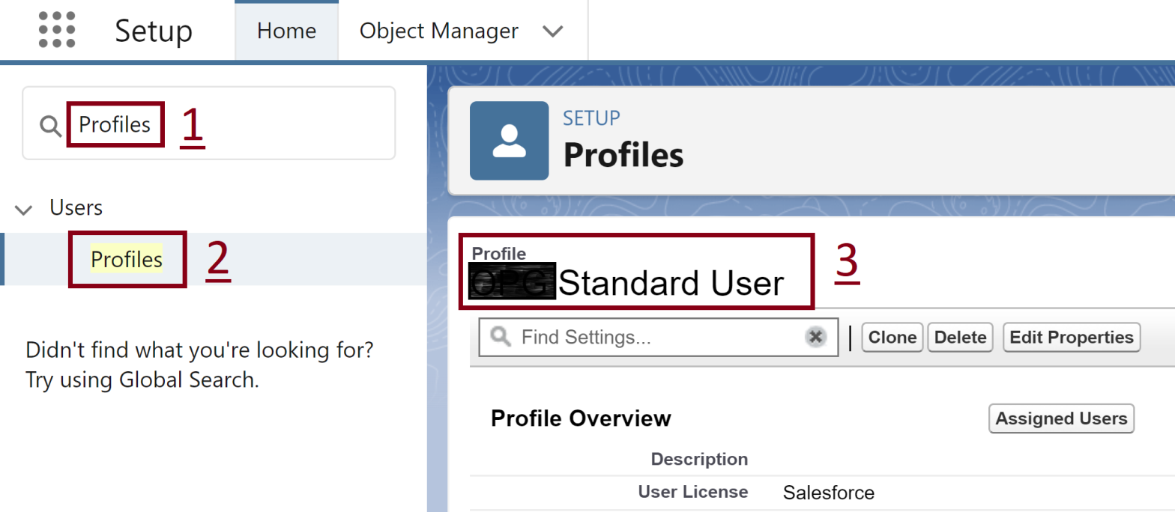
4. Open a Profile

Slide 38
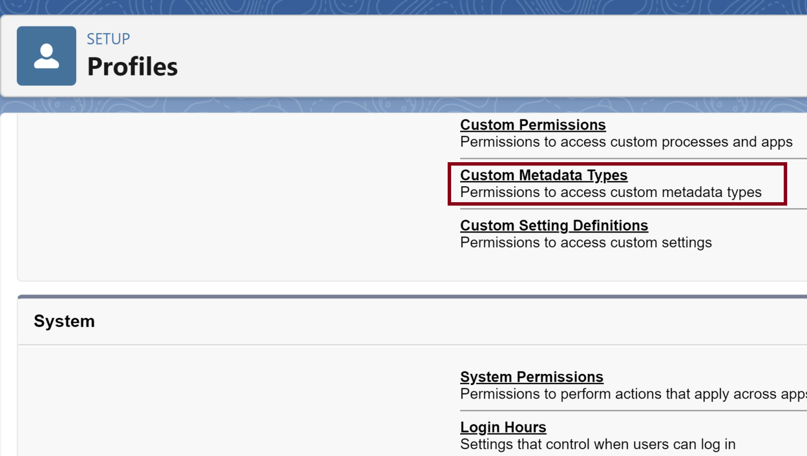
5. Go to Custom Metadata Types

Slide 39
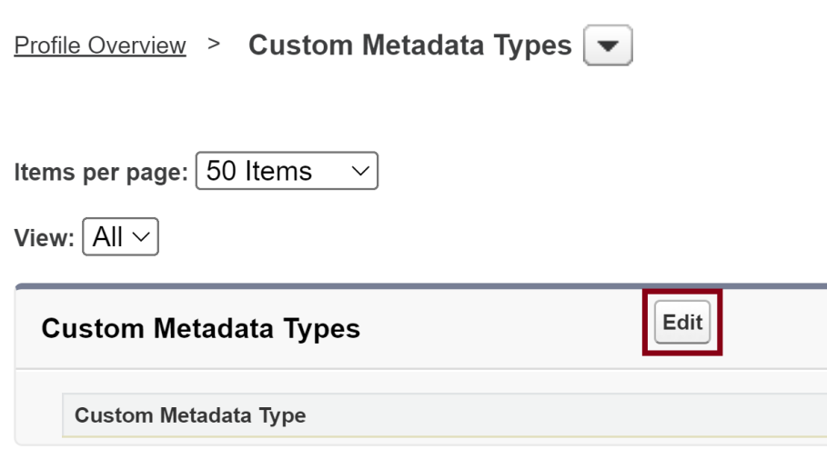
6. Edit Custom Metadata Types

Slide 40
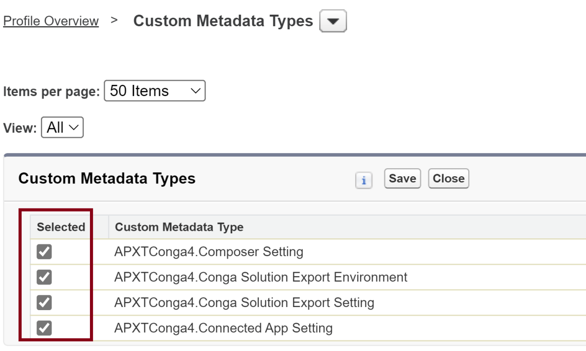
7. Enable Conga Custom Metadata Types

Slide 41
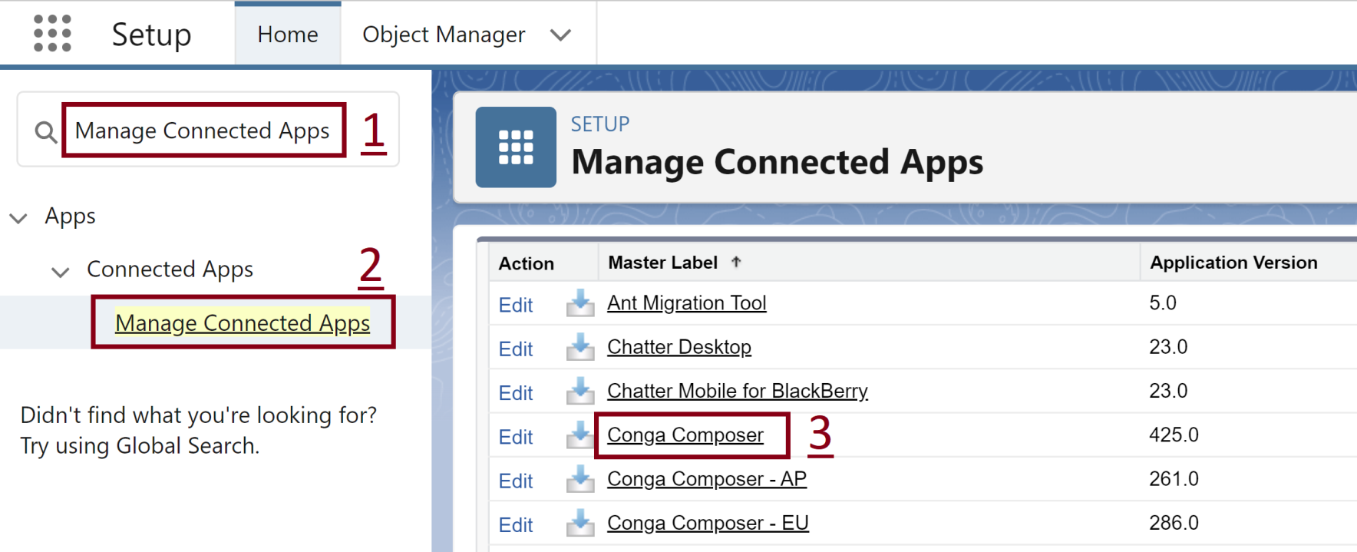
8. Open Conga Composer App

Slide 42
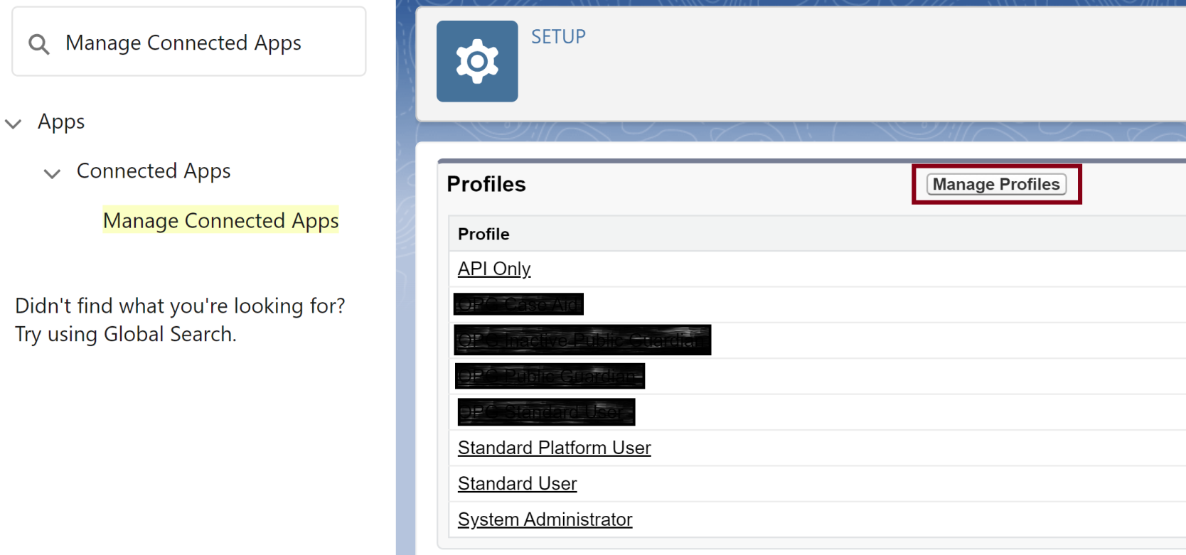
9. Grant Conga Access for Profiles

Slide 44
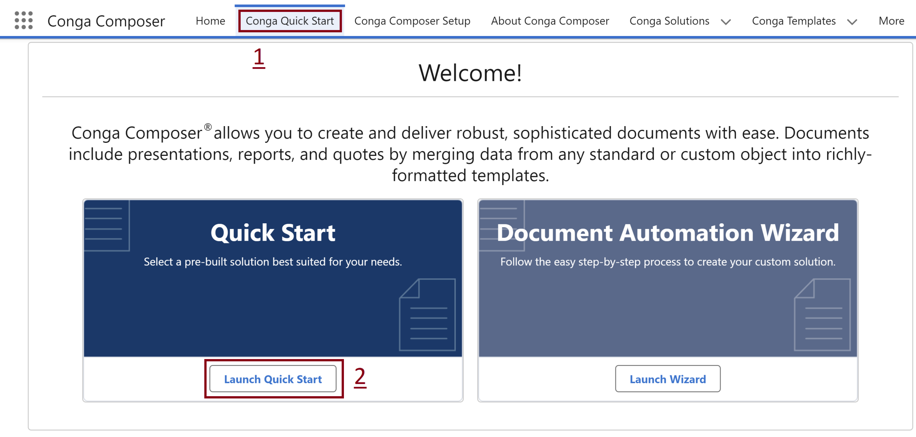
1. Open Quick Start

Slide 45
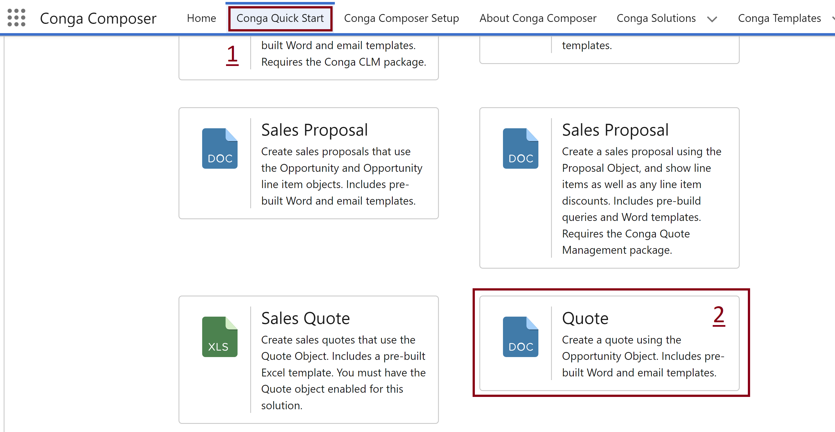
2. Create Examples

Slide 46
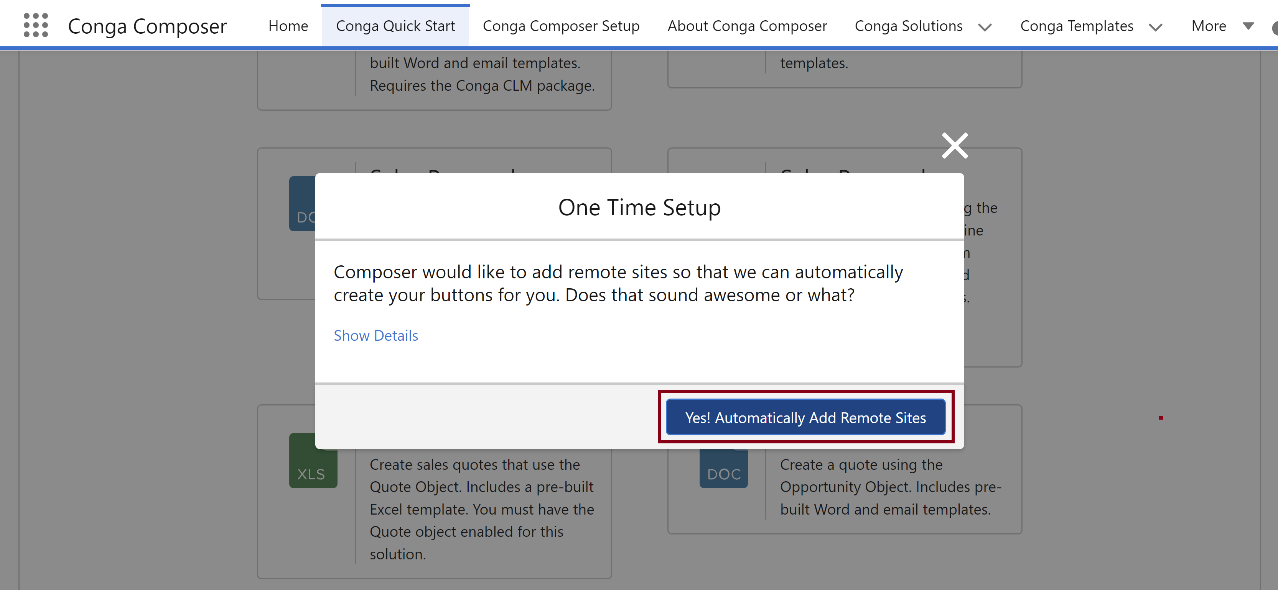
3. Add Remote Sites

Slide 48
1. Get Started with Conga Composer
https://www.youtube.com/watch?v=f4126pcslzE
https://www.youtube.com/watch?v=rn5_94w8vT4
https://www.youtube.com/watch?v=zyFsooKBqdg
https://www.youtube.com/watch?v=ehf2VNj9O9k

Slide 49
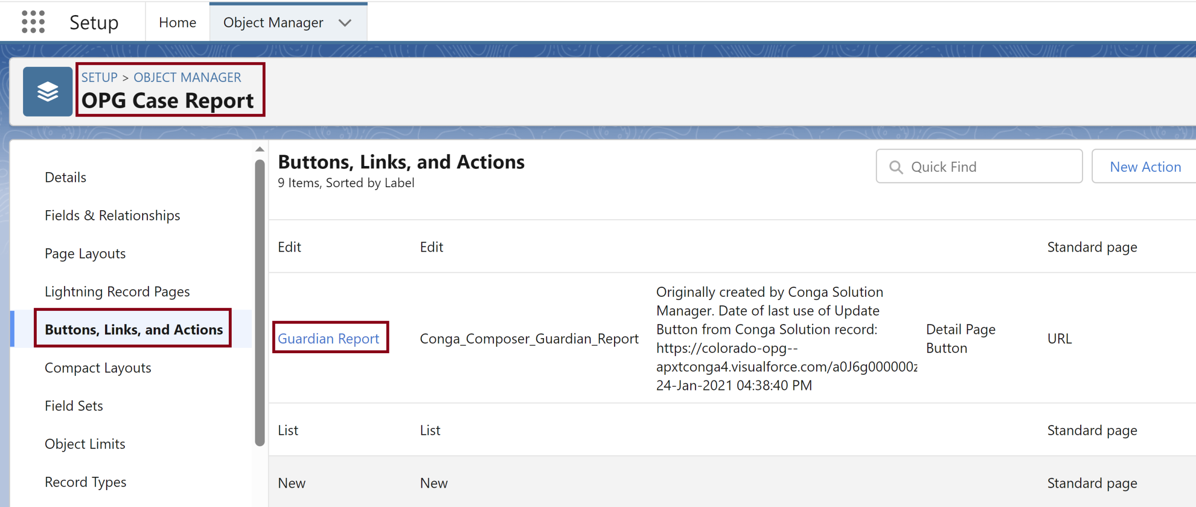
2. Edit a Button

Slide 50
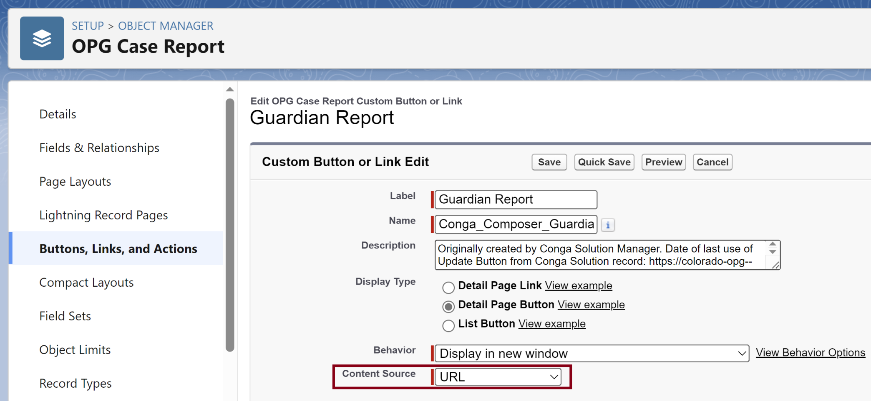
3. Customize a Button

Slide 51
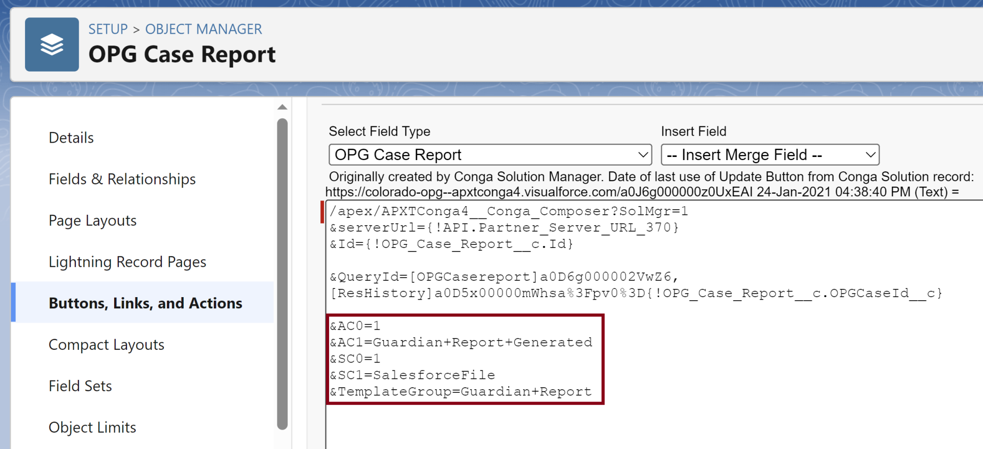
4. Review Built-in Parameters
https://documentation.conga.com/composer/latest/salesforce/ac0-143198803.html
AC0: Specifies whether to automatically log an activity after merging.
AC1: Sets the Subject to the text specified. Also used as the subject of a Follow-Up Task, if one is created.

Slide 52
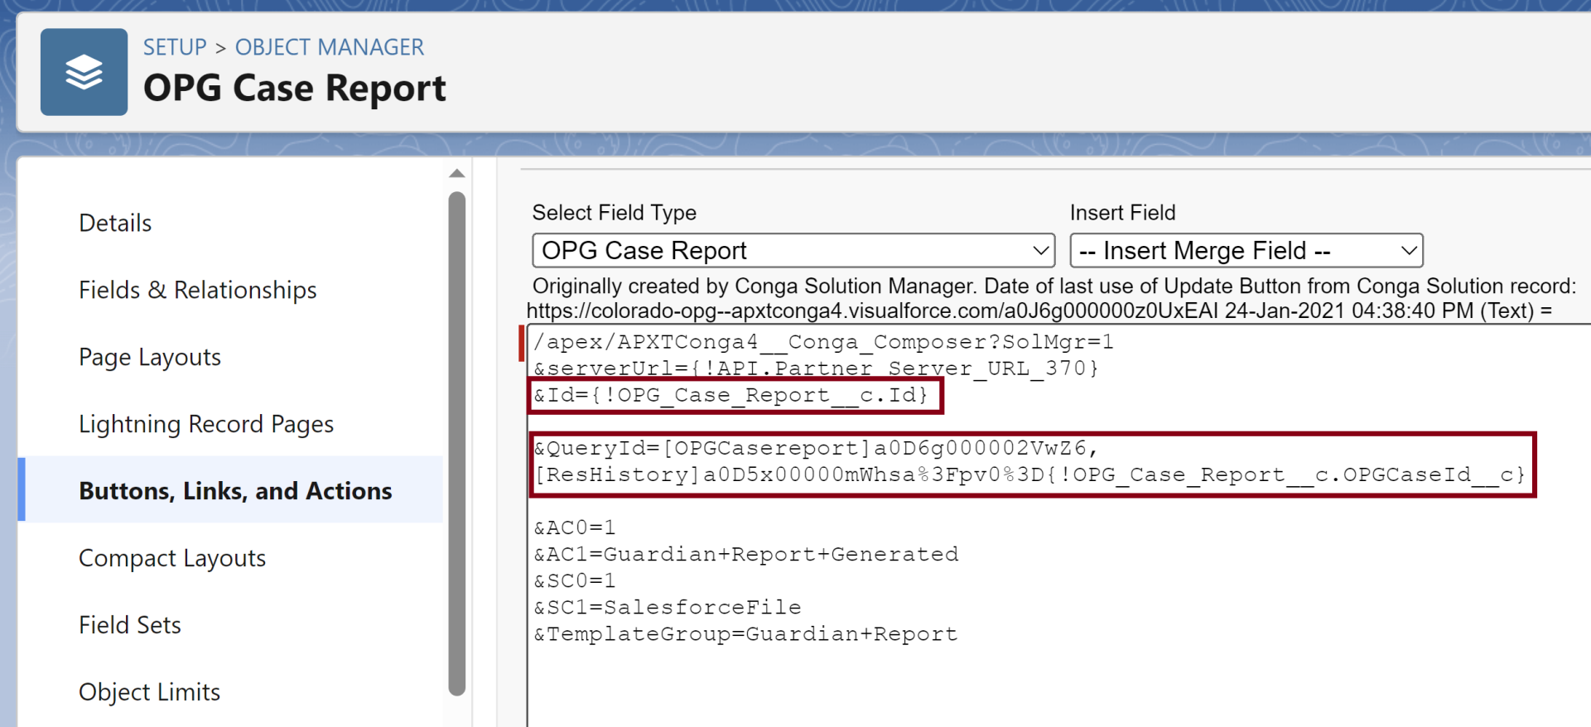
5. Review Id & Query Parameter

Slide 54
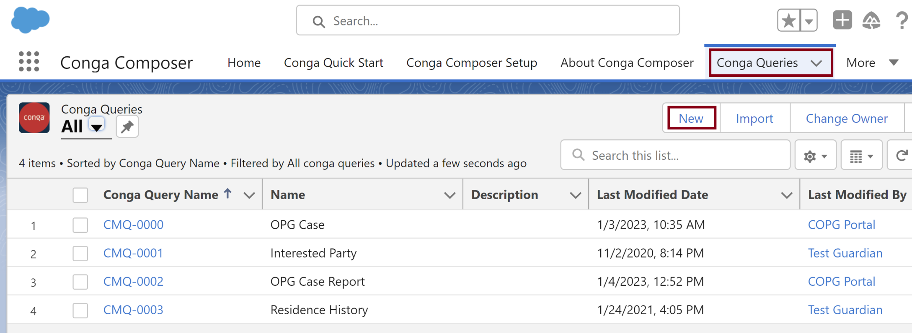
1. Create a Conga Query

Slide 55
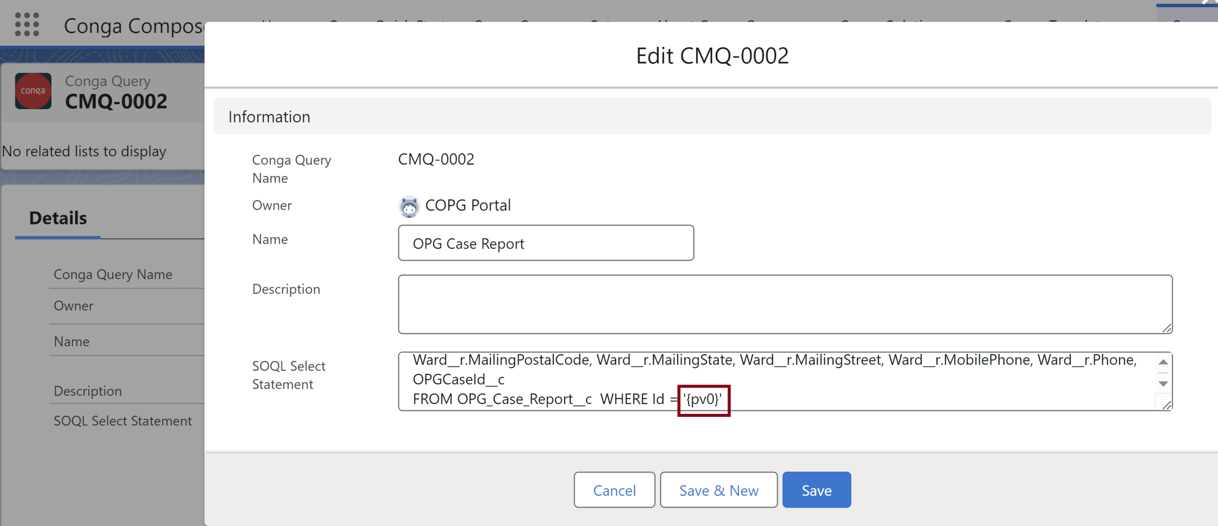
2. Enter SOQL Select Statement

Slide 56
pv Value
https://documentation.conga.com/composer/latest/salesforce/dynamically-filter-reports-and-queries-with-pv-values-143198617.html
PV (or pv) stands for parameter value, which is a value that can be passed into a filter on a Salesforce report or Conga query.
The first filter on a report or query is called pv0, the second pv1, the third pv2, and so on.
Composer's default behavior is to pass the master object record Id into the pv0 filter.

Slide 57
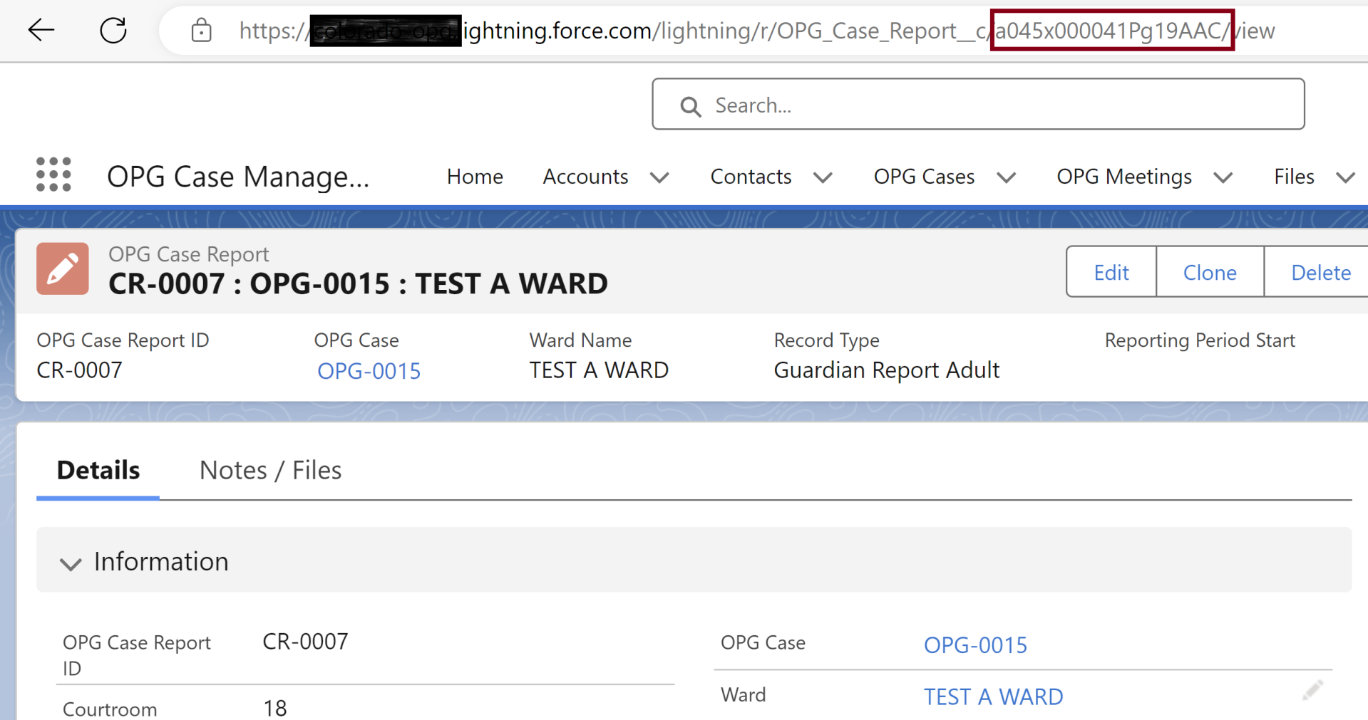
3. Copy Object Id Value

Slide 58
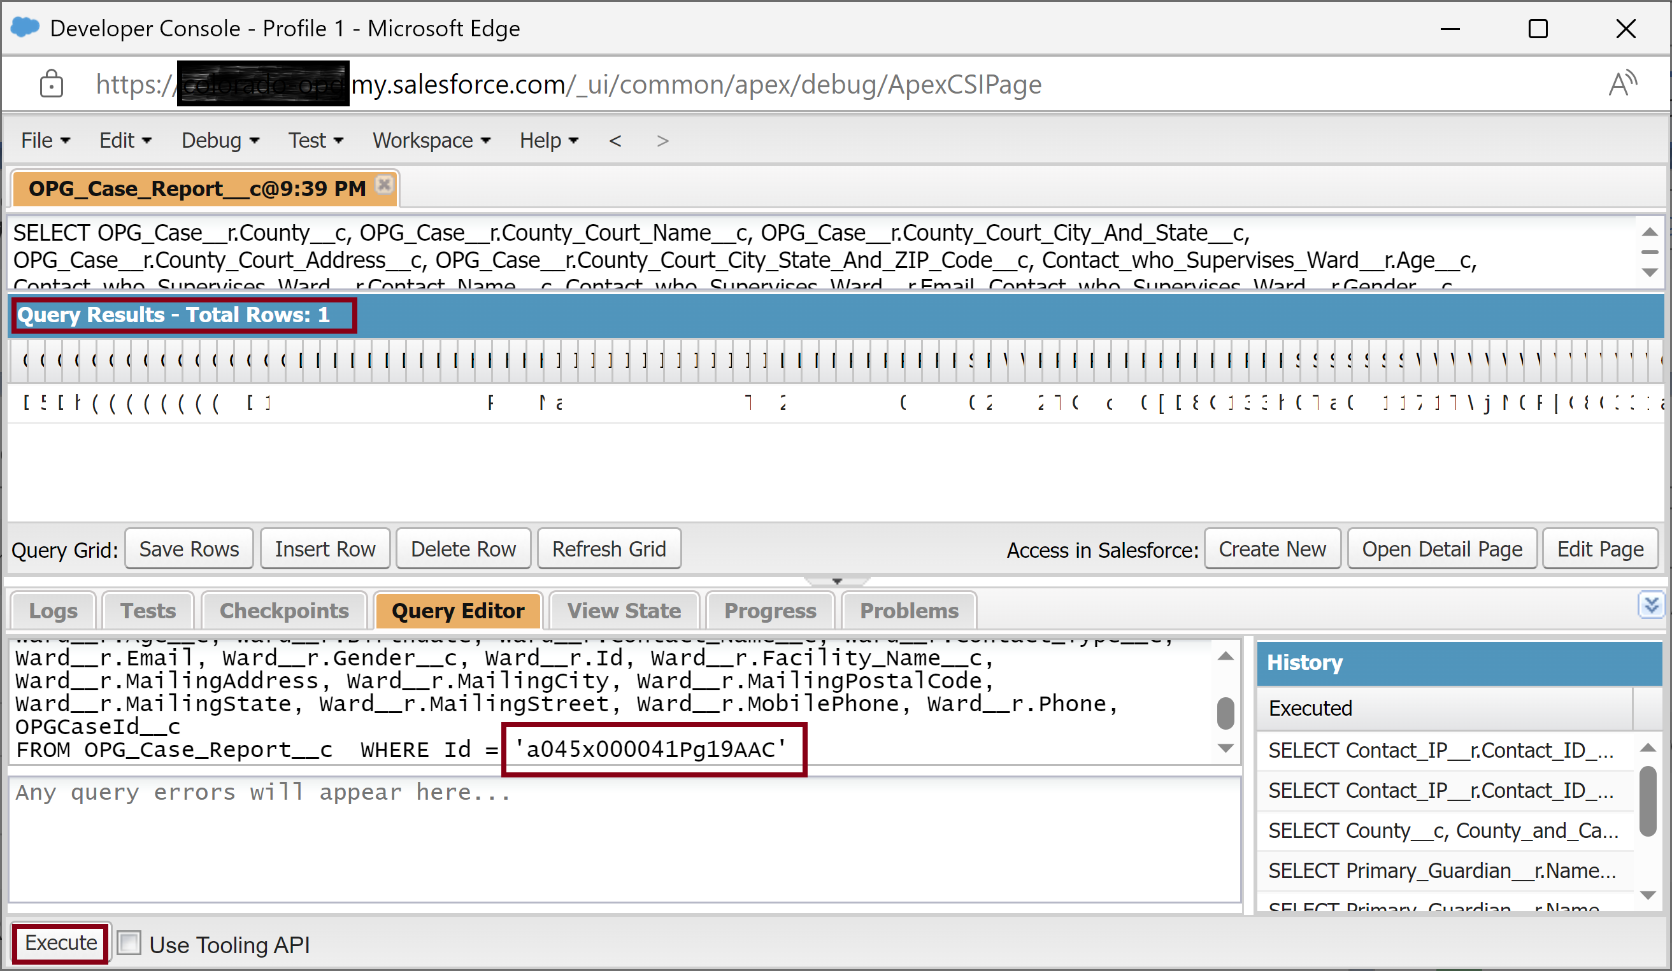
4. Test Query using Object Id Value

Slide 60
QueryId
https://documentation.conga.com/composer/latest/salesforce/queryid-195697210.html
QueryID retrieves the SOQL query stored in the specified Salesforce record, executes the SOQL query and makes the SOQL query results available through a dataset as seen on the Template Builder window.
You may include up to 50 QueryID values in a Conga Composer URL, thus making 50 queries accessible in a single merge operation.
Example of two Queries: &QueryId=[Contacts]a00143532453dg32,[Cases]a00143532453dg32

Slide 61
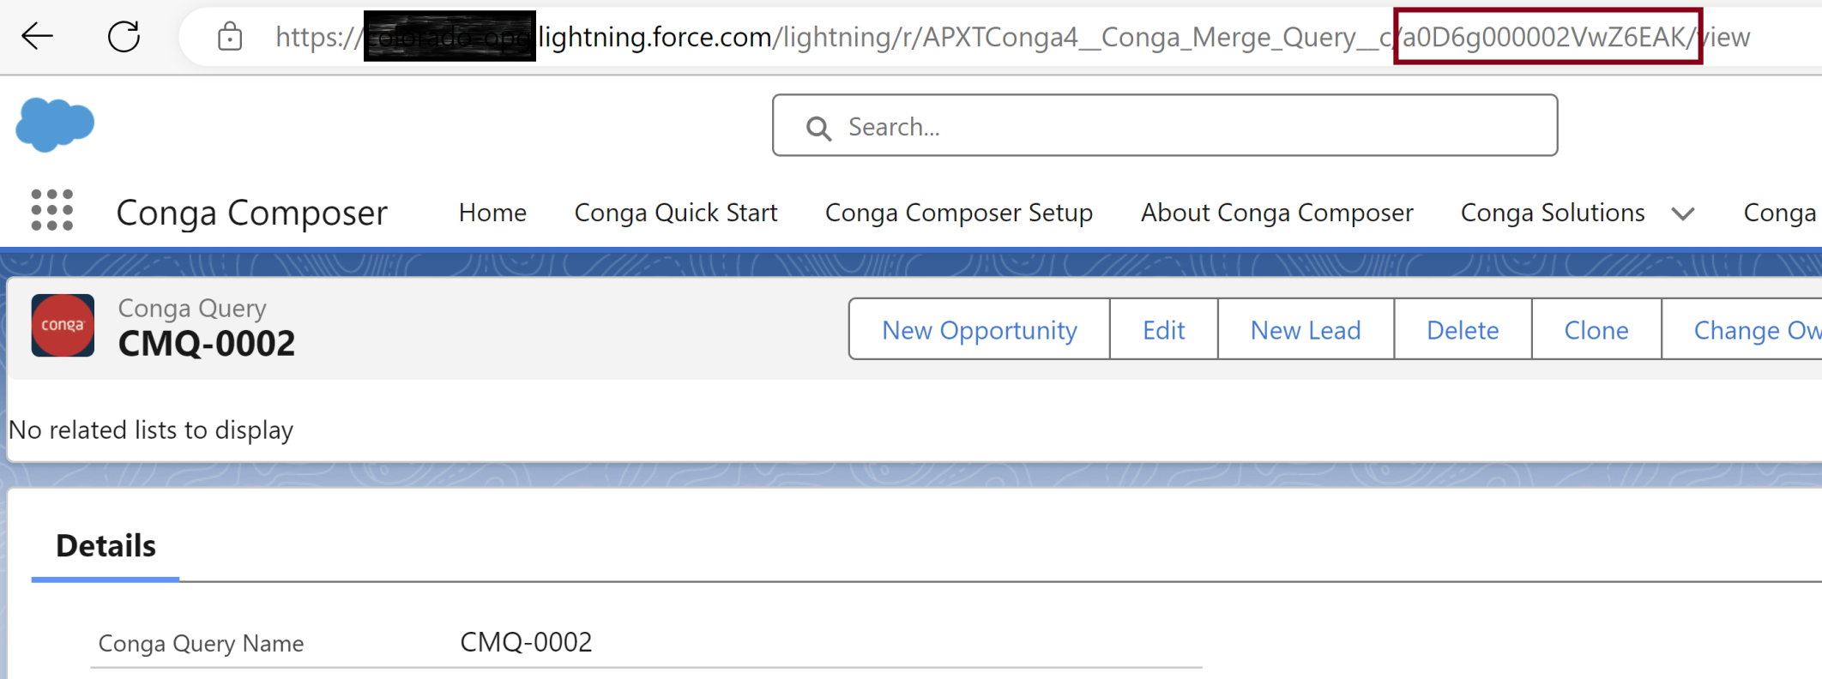
1. Copy Query Id Value

Slide 62
2. Modify Query Parameter

Slide 63
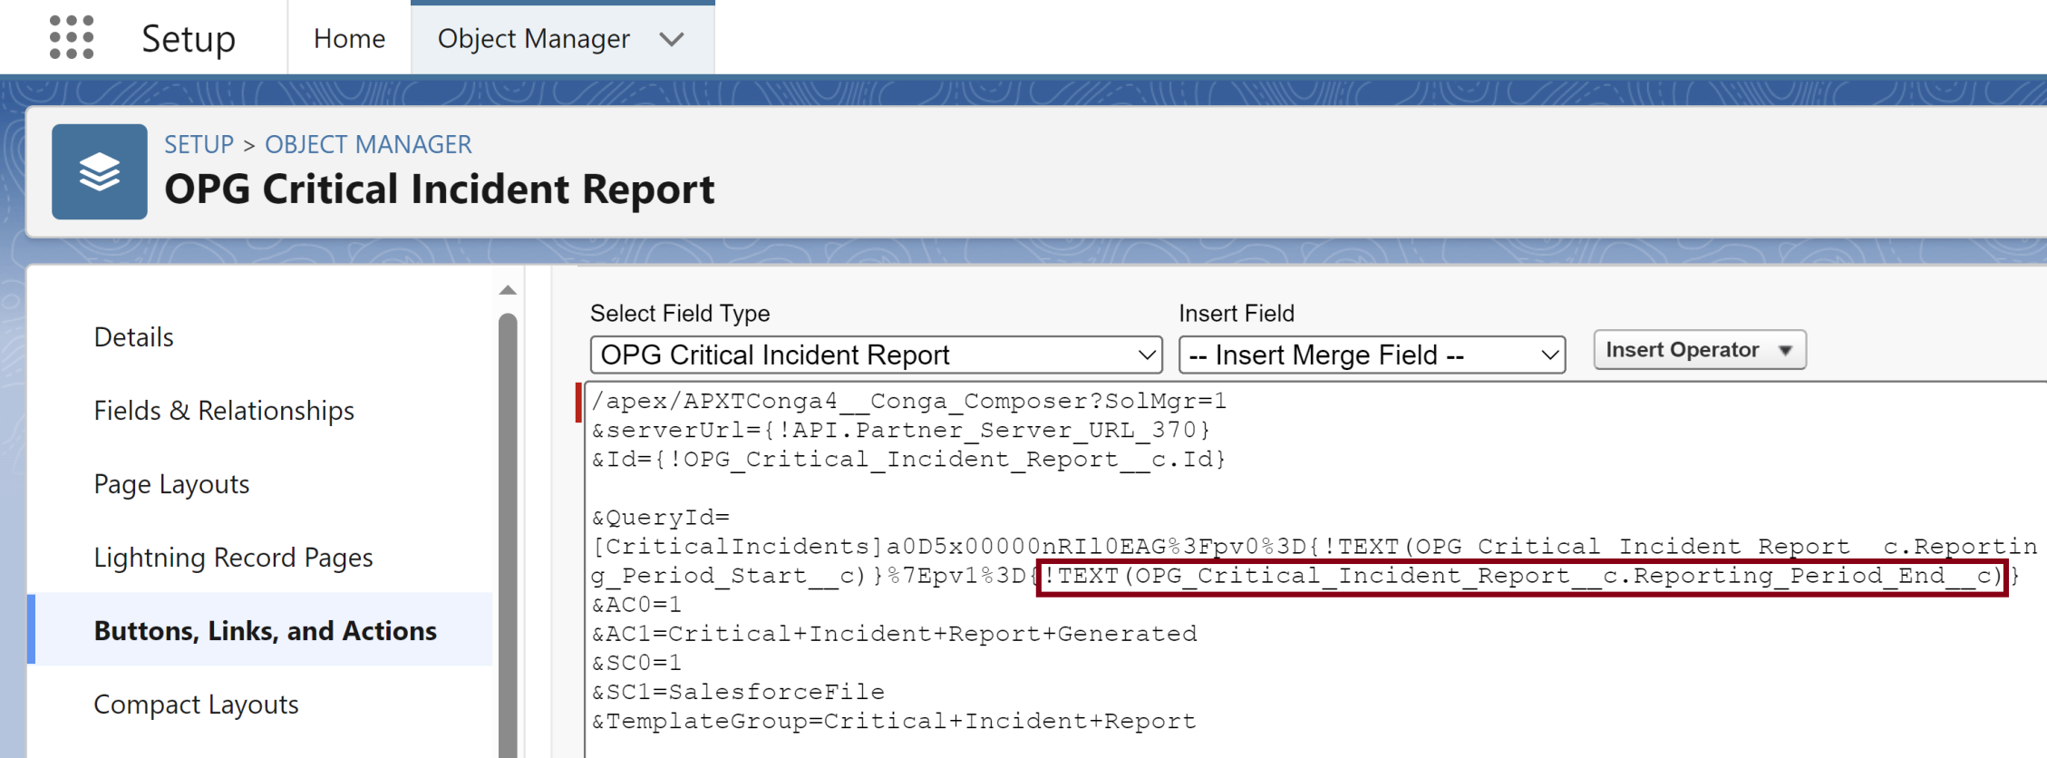
3. Pass Date Range Parameter
https://documentation.conga.com/composer/latest/salesforce/queries-to-parse-data-in-a-conga-batch-or-workflow-formula-143199138.html

Slide 64
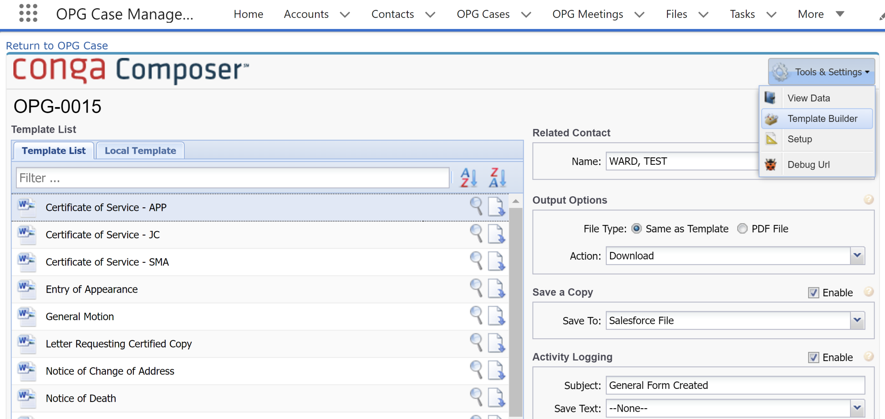
4. Open Template Builder

Slide 65
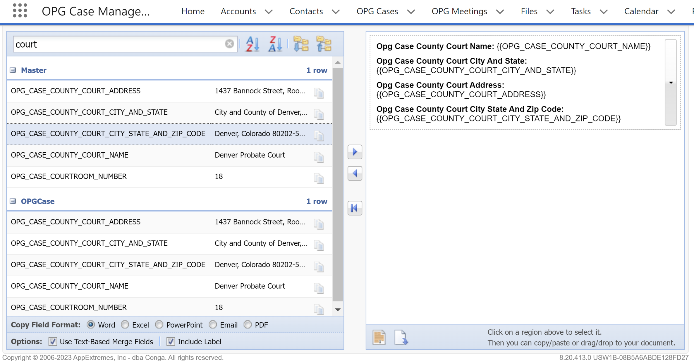
5. Copy Template Regions
1
2

Slide 66
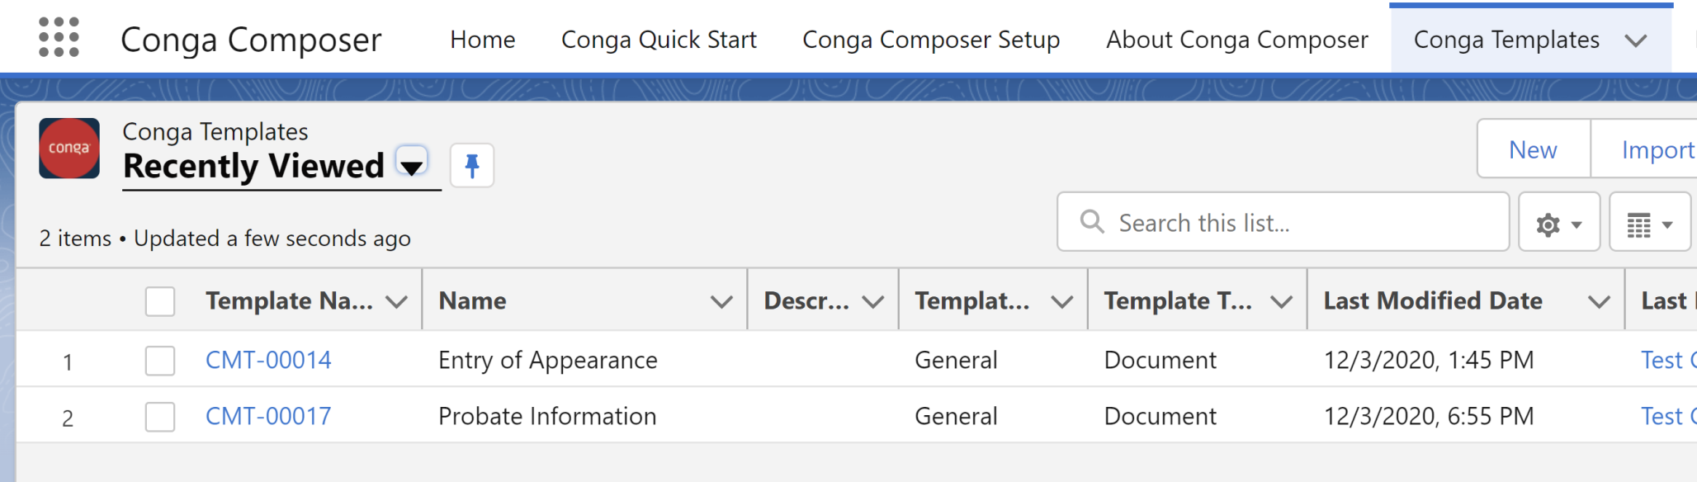
6. Create a Template

Slide 67
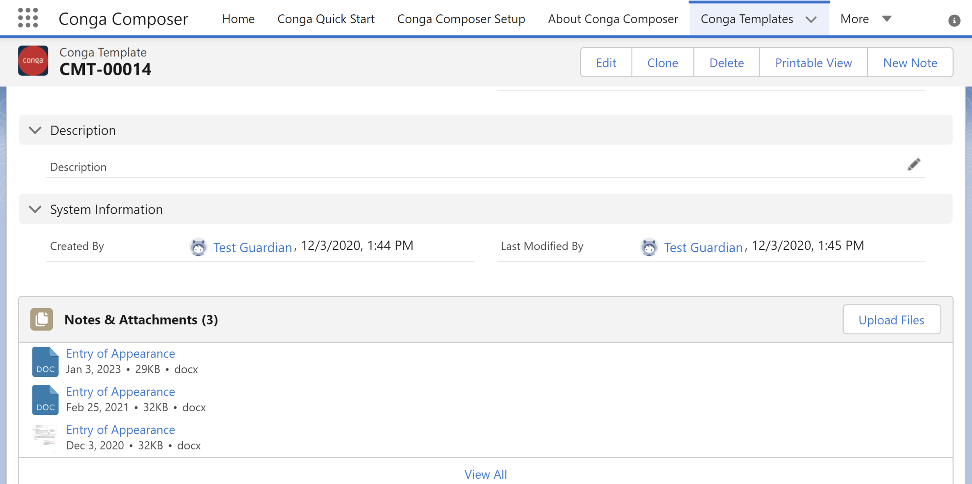
7. Upload a Template File

Slide 68
Include Error in Template for Debugging
Error
{{TableStart:CriticalIncidents}}{{Error}}{{TableEnd:CriticalIncidents}}

Slide 69
Format Date Values in Word
https://documentation.conga.com/composer/latest/salesforce/format-date-values-in-word-143198654.html
Reporting Period Start | {{OPG_CRITICAL_INCIDENT_REPORT_REPORTING_PERIOD_START \@ MM/dd/yyyy}}
Reporting Period End | {{OPG_CRITICAL_INCIDENT_REPORT_REPORTING_PERIOD_END \@ MM/dd/yyyy}}

Slide 70
Format Currency Values in Word
https://documentation.conga.com/composer/latest/salesforce/format-number-values-in-word-203496158.html
{{OPPORTUNITY_AMOUNT \# #,##0}} | 5,280
{{OPPORTUNITY_AMOUNT \# $#,##0}} | $5,280
{{OPPORTUNITY_AMOUNT \# $#,##0.00}} | $5,280.25
{{OPPORTUNITY_AMOUNT \# Currency}} | $5,280.25

Slide 71
Nested SOQL Queries
https://documentation.conga.com/composer/latest/salesforce/nested-soql-queries-143901344.html
Purpose: To create child reports.

Slide 73
ReportId
https://documentation.conga.com/composer/latest/salesforce/reportid-195697234.html
The 15-character Salesforce ID of a Report.
Retrieves the contents of the specified report (identified by its 15-character Salesforce Id) and makes the report contents available through a dataset as seen on the Template Builder window.
Example: &ReportId=00143532453dg3A
Two Reports: &ReportId=00O43532453dg3A,00O43532453dgF2
Report with Alias: &ReportId=[MyContacts]00143532453dg3A
Report with Two Aliases: &ReportId=[MyAccounts]00O43532453dg3A,[MyCases]00O43532453dgF2

Slide 74
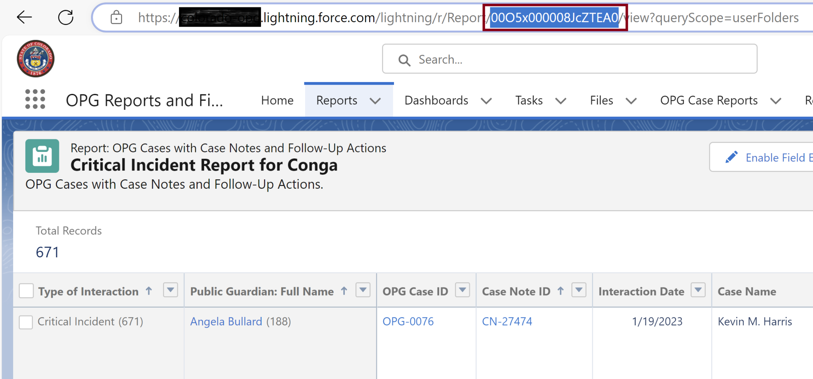
1. Copy Report Id Value

Slide 75
2. Modify Query Parameter

Slide 77
1. Add Custom Button to Lightning Record Pages
In Salesforce Setup, open Object Manager.
Search for the object in the quick find on the right and choose the object on the left.
Verify the button exists on the object in "Buttons, Links, and Actions".
Select Lightning Record Pages.
Choose the correct page by Label.
On the Lightning page, choose Edit.
Choose the Highlights Panel (the section at the top of the page with the key).
On the right pane, verify that Dynamic Actions has been enabled. If Dynamic Actions is not enabled, you'll be prompted to enable it in order to proceed.
Scroll down and choose Add Action.
Find and add the desired button to the Lightning Record Page.
Open a record using this Lightning record page and confirm the presence of the button.

Slide 78
Build a Composer solution using Solution Manager
https://conga.com/resources/build-composer-solution-using-solution-manager-video
Purpose: To create a button with parameters using UI.

Slide 80
Salesforce Document Generation
https://help.salesforce.com/s/articleView?id=ind.sf_docgen_what_can_you_do_three.htm&type=5

Slide 82
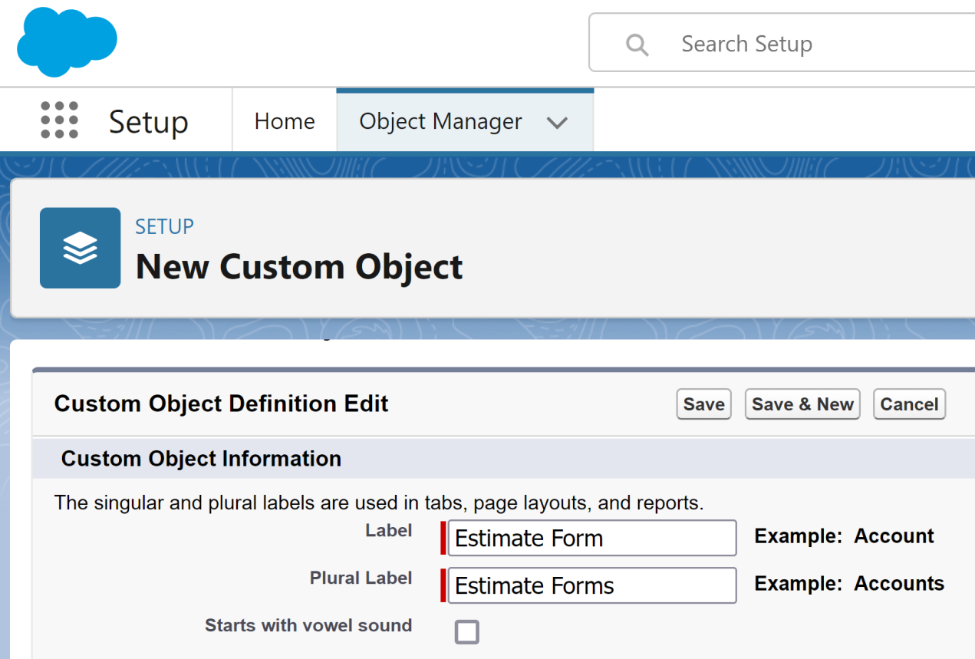
1. Create Custom Object
Select Launch New Custom Tab Wizard after saving this custom object option.

Slide 83
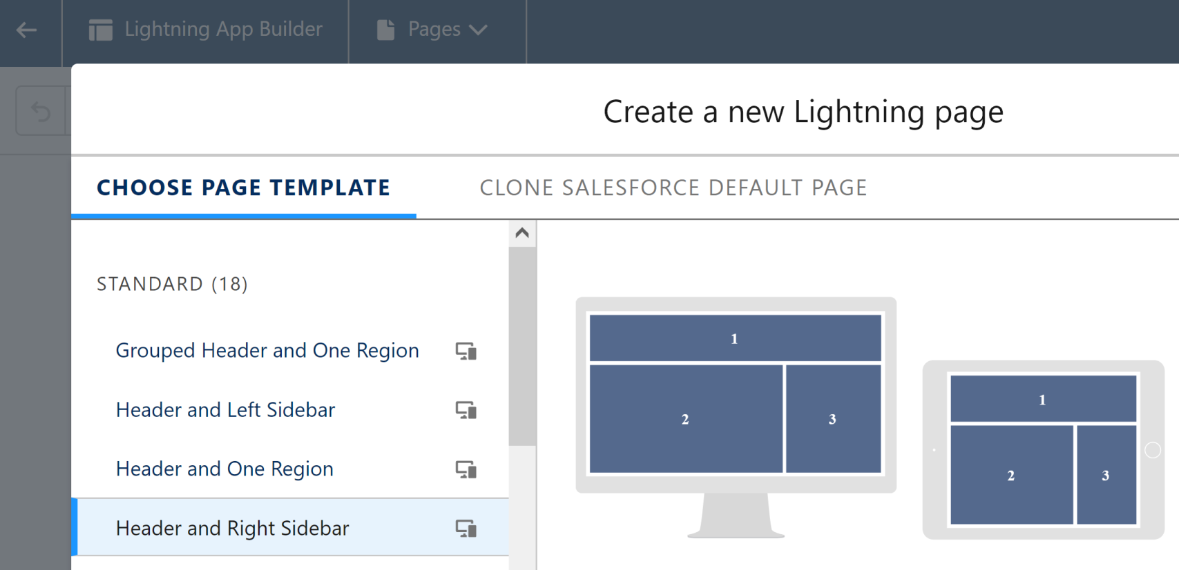
2. Create Record Page for Object
Select Header and Right Sidebar template.
Add Record detail component, Highlights panel component, Related List - Single component for Notes & Attachments.

Slide 84

3. Create Lightning App for Object

Slide 85

4. Create Object Fields

Slide 86

Thank You & See You Again

